Slide 1
EN. 601.647/667 Introduction to HLT Machine Translation
Kenton Murray
9/26/2023
Slides in part thanks to:
Kevin Duh
David Chiang
Kevin Knight

Slide 2
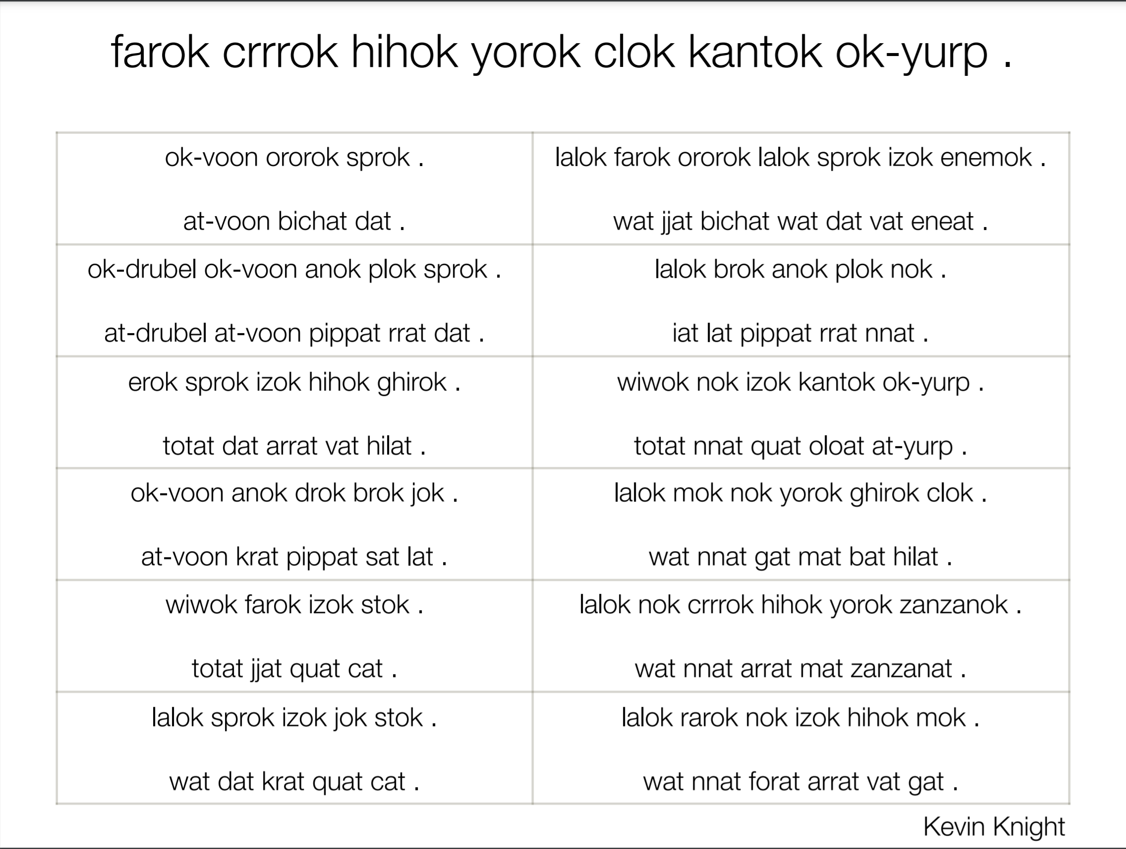

Slide 3
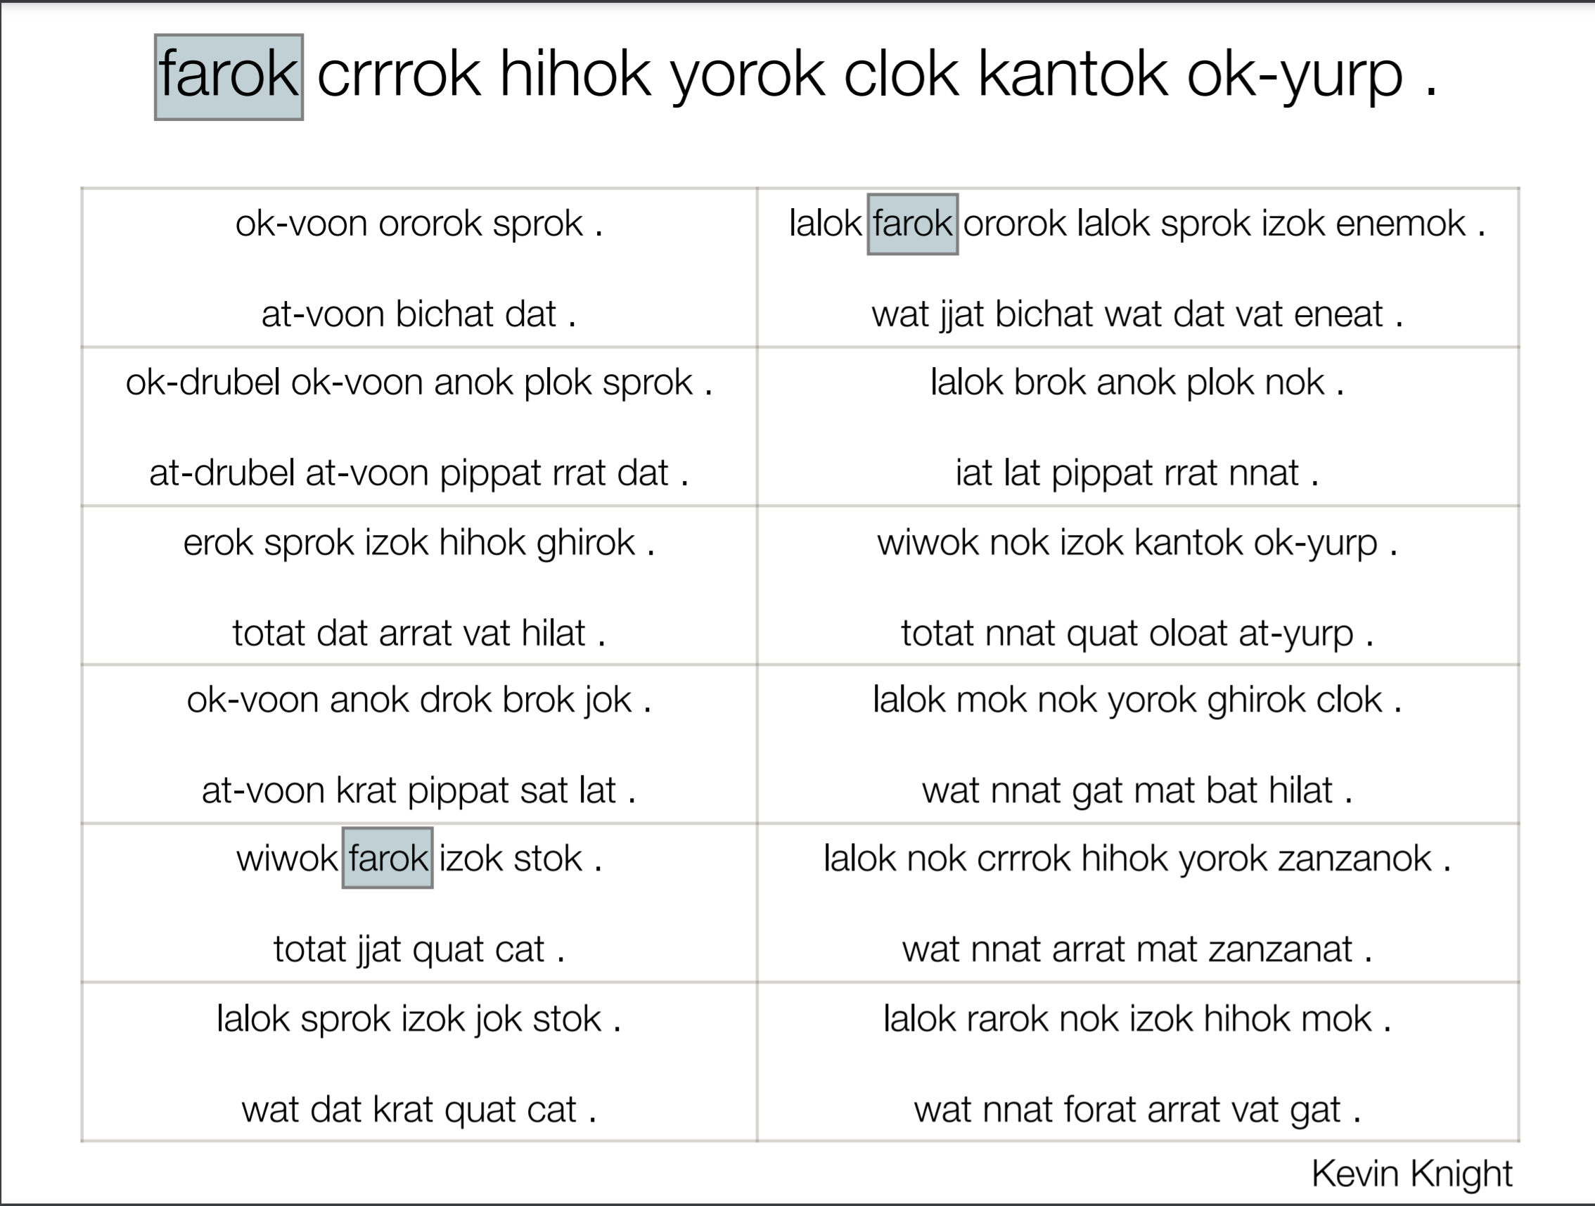

Slide 4
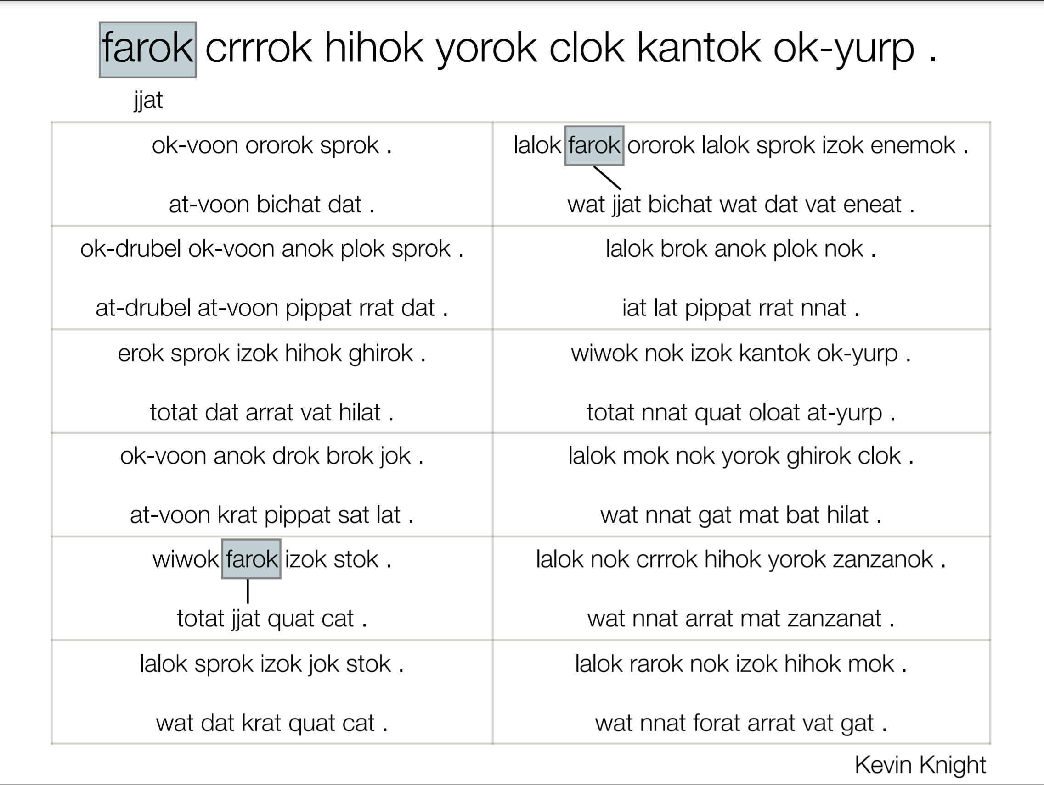

Slide 5
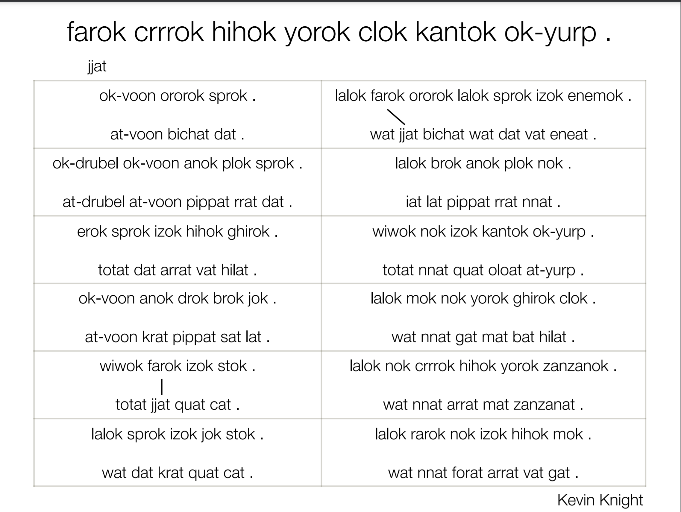

Slide 6
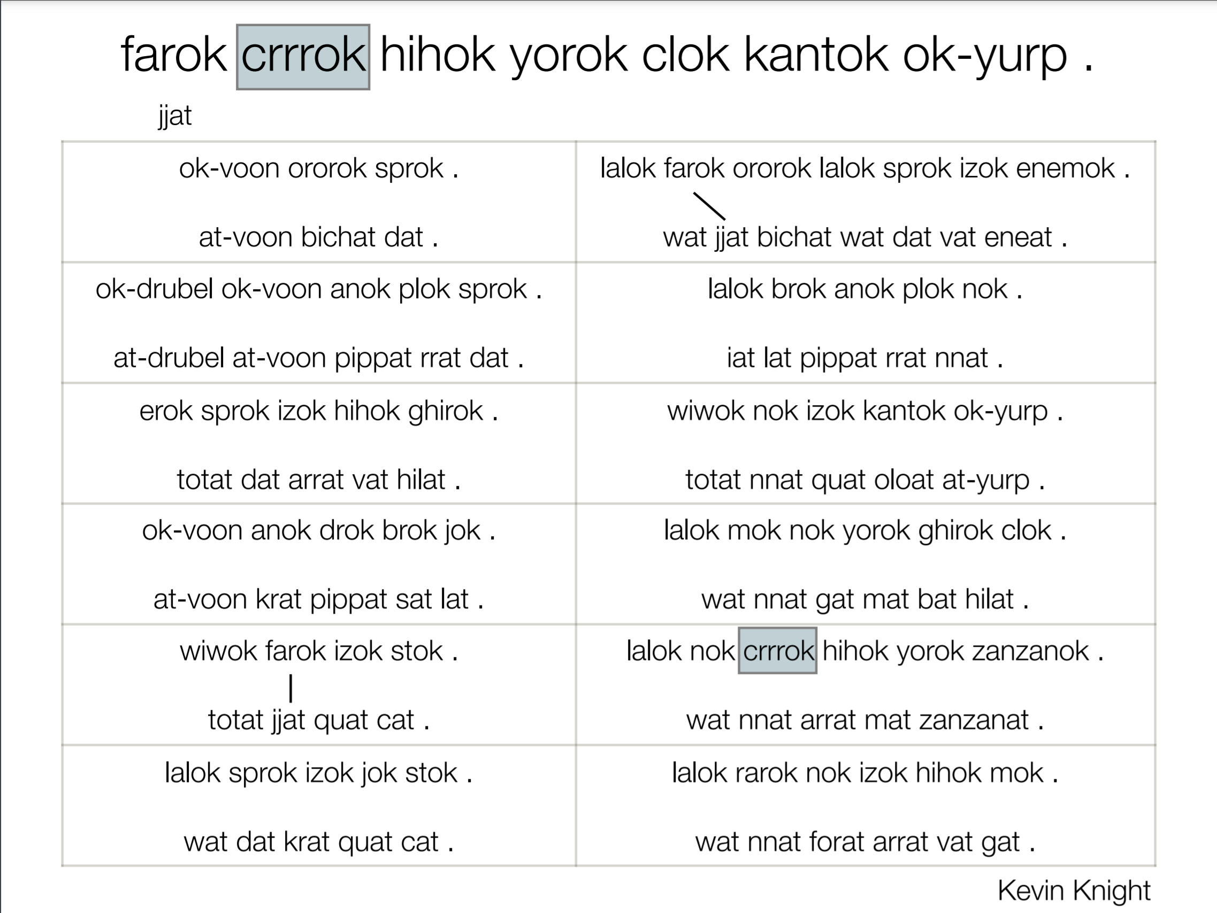

Slide 7
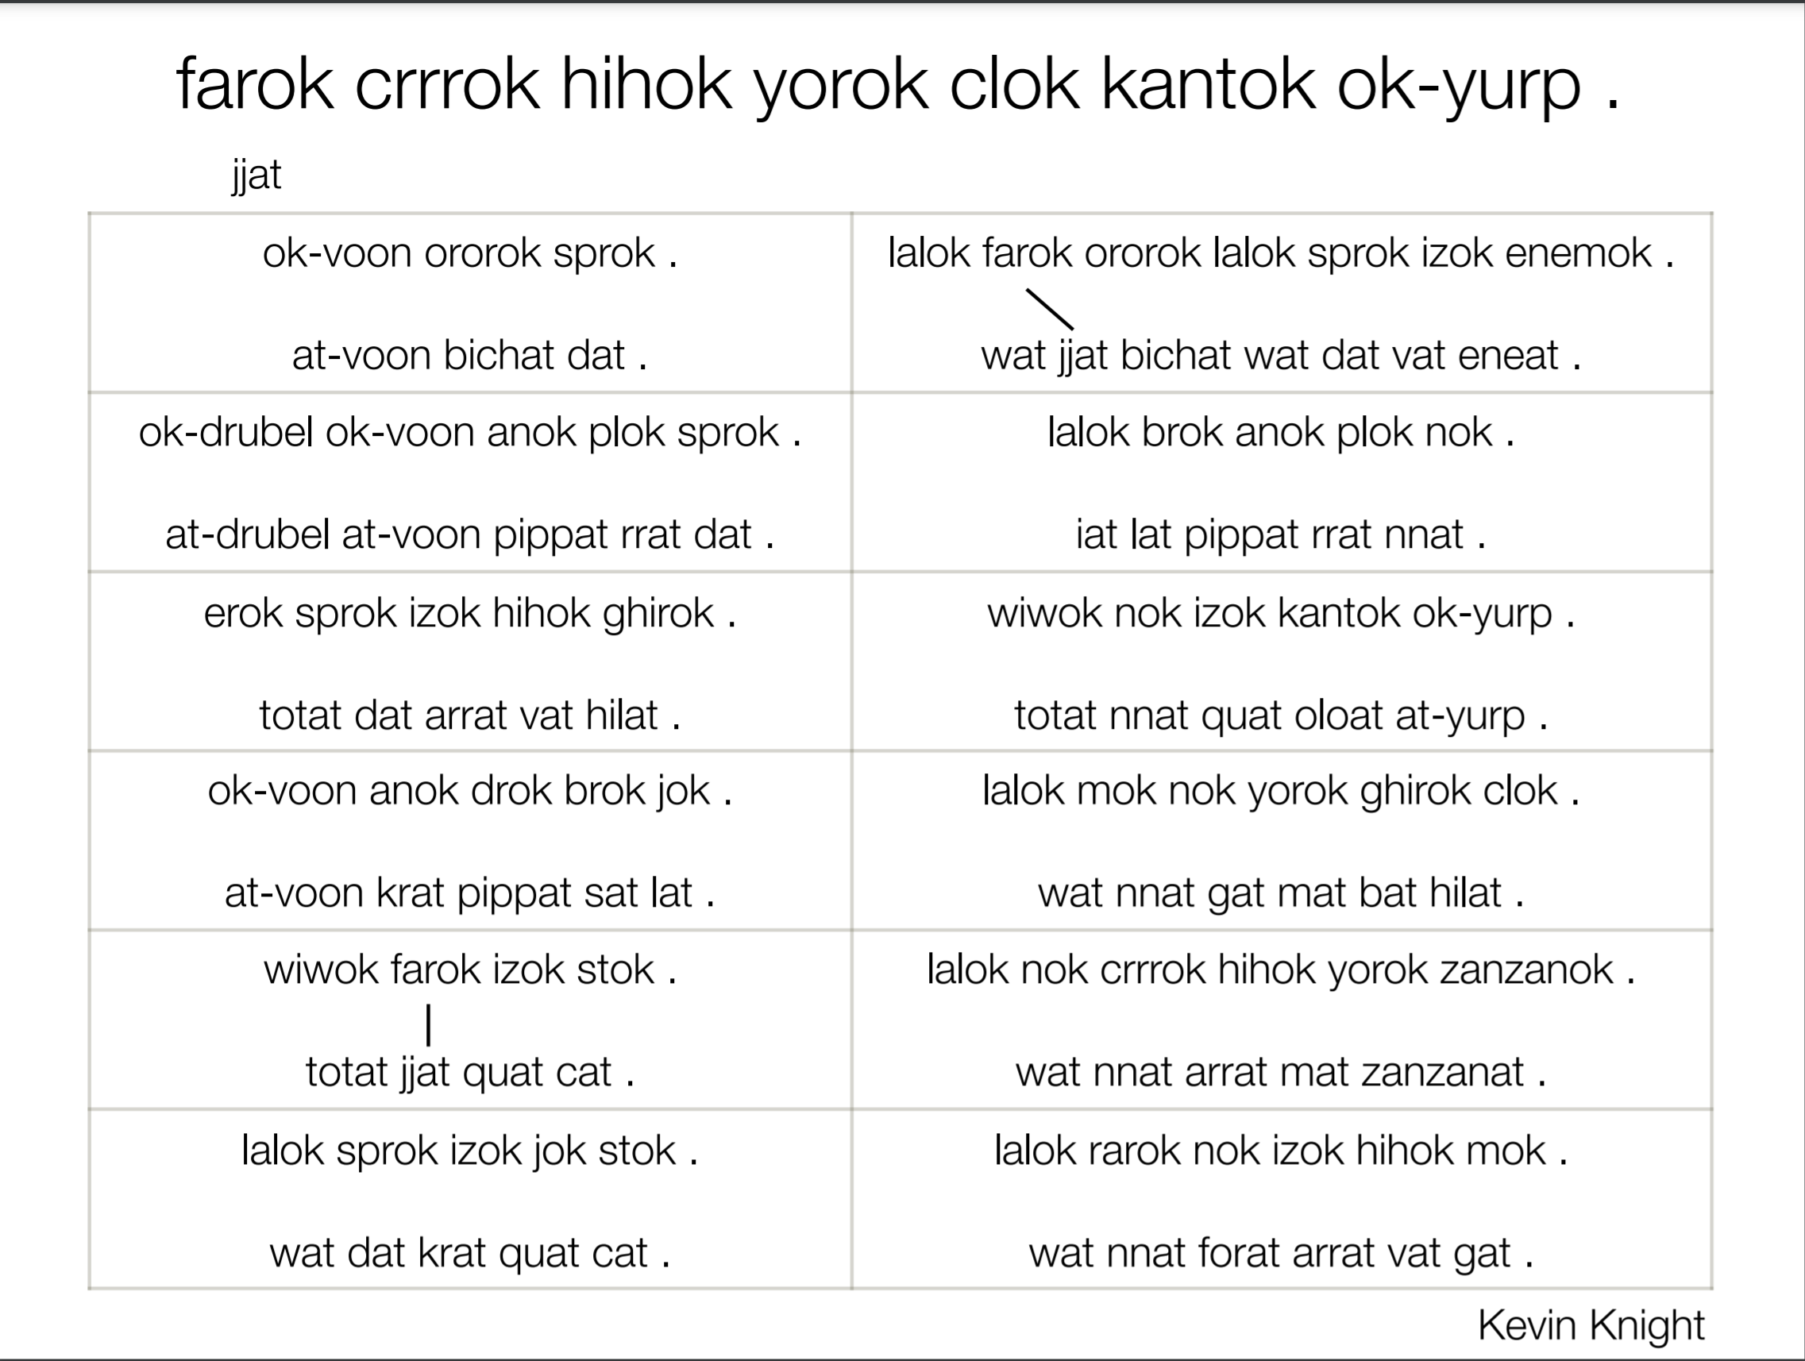

Slide 8
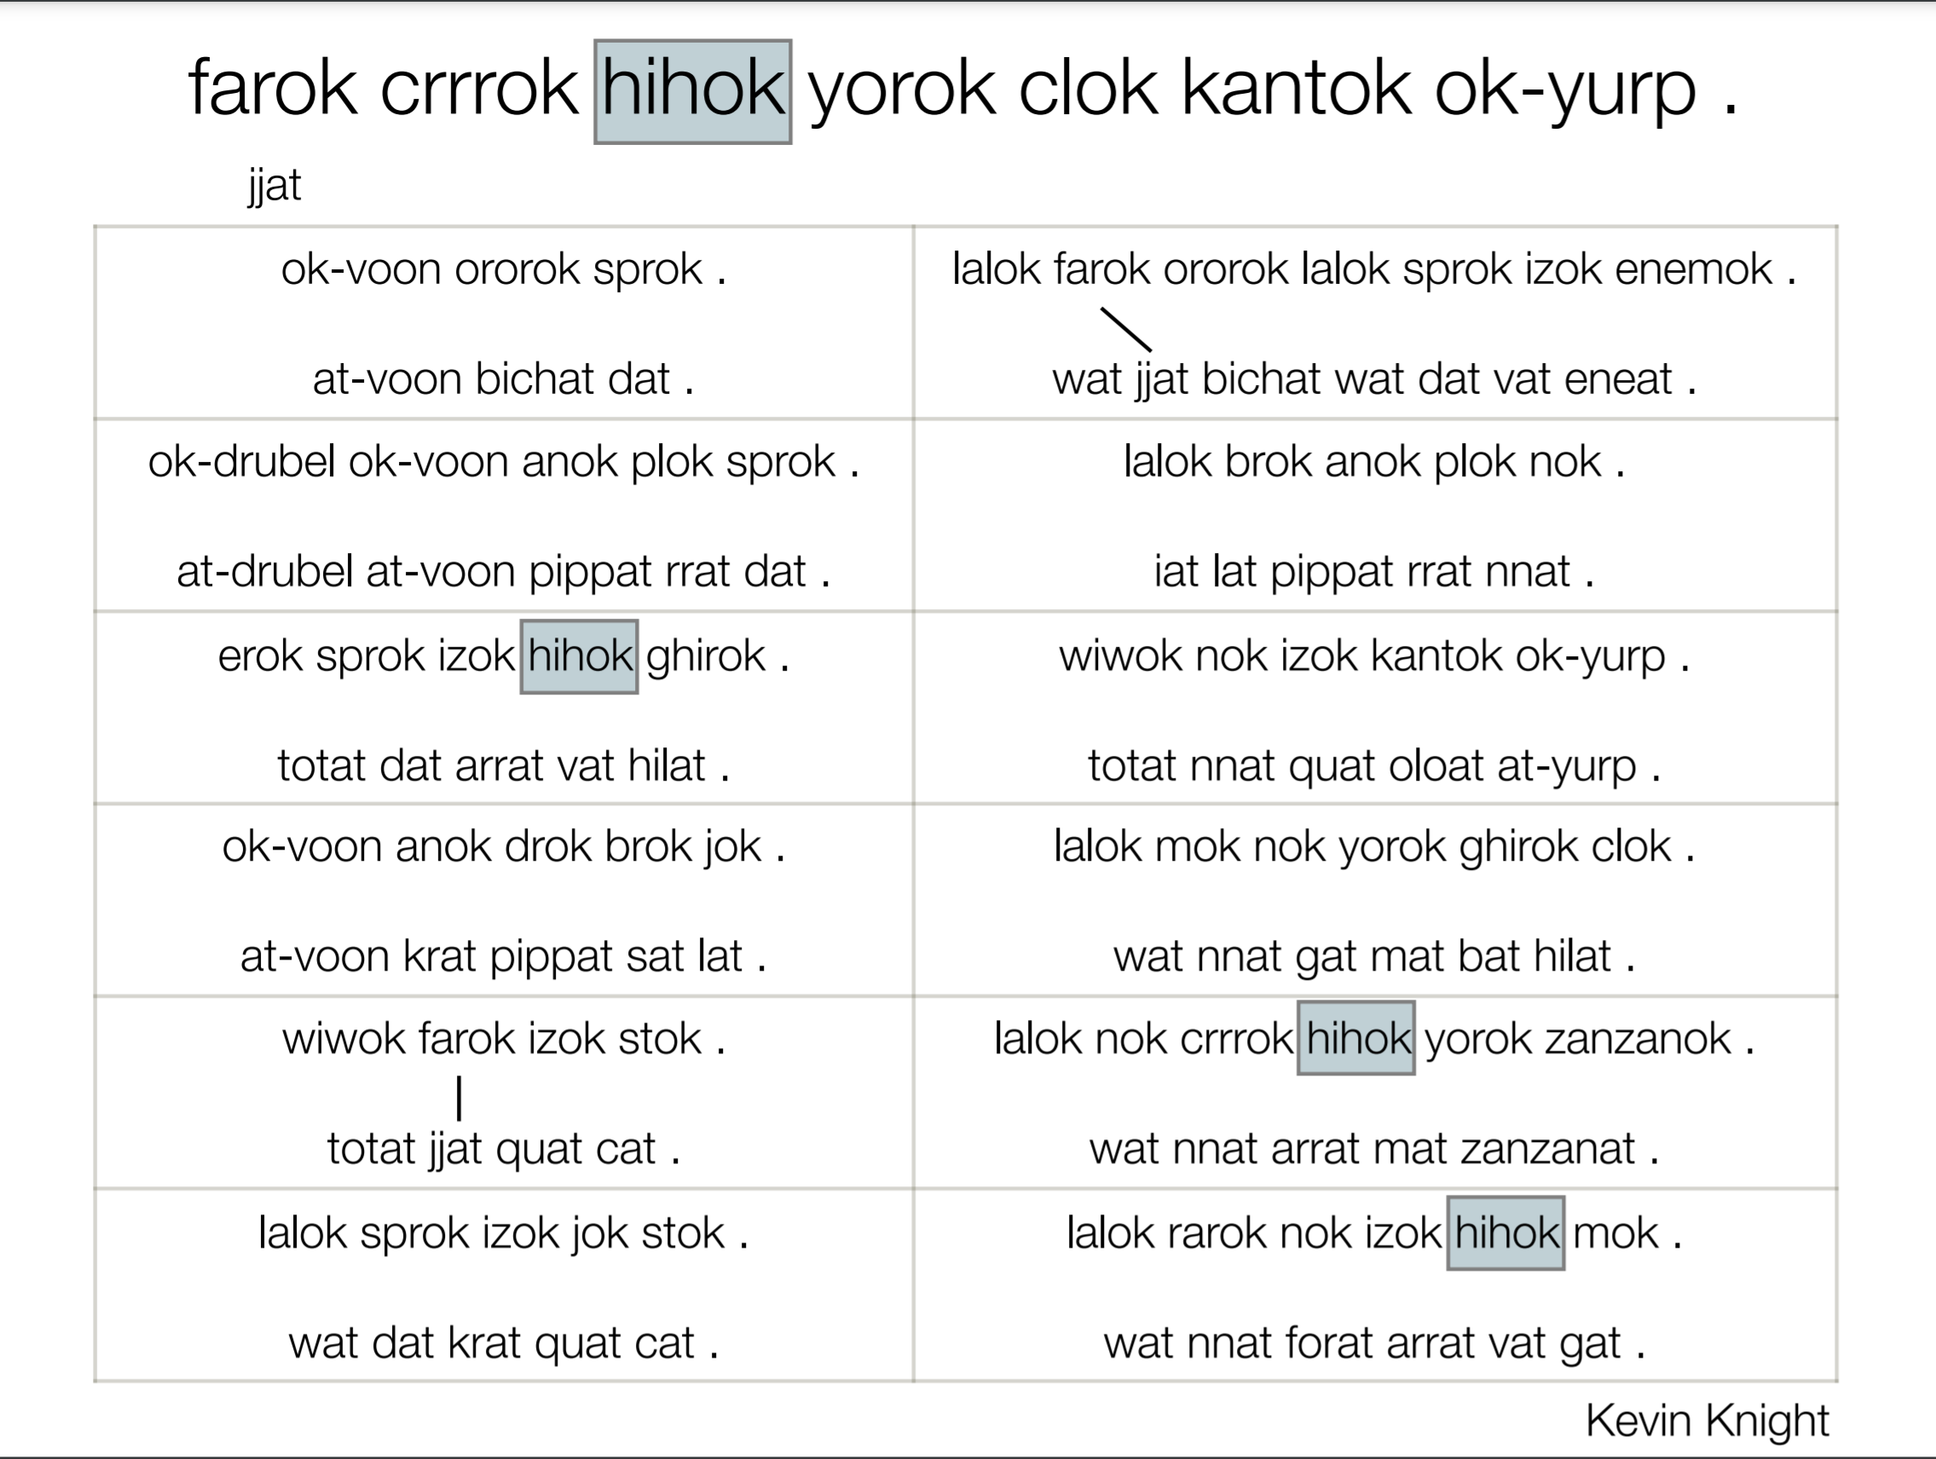

Slide 9
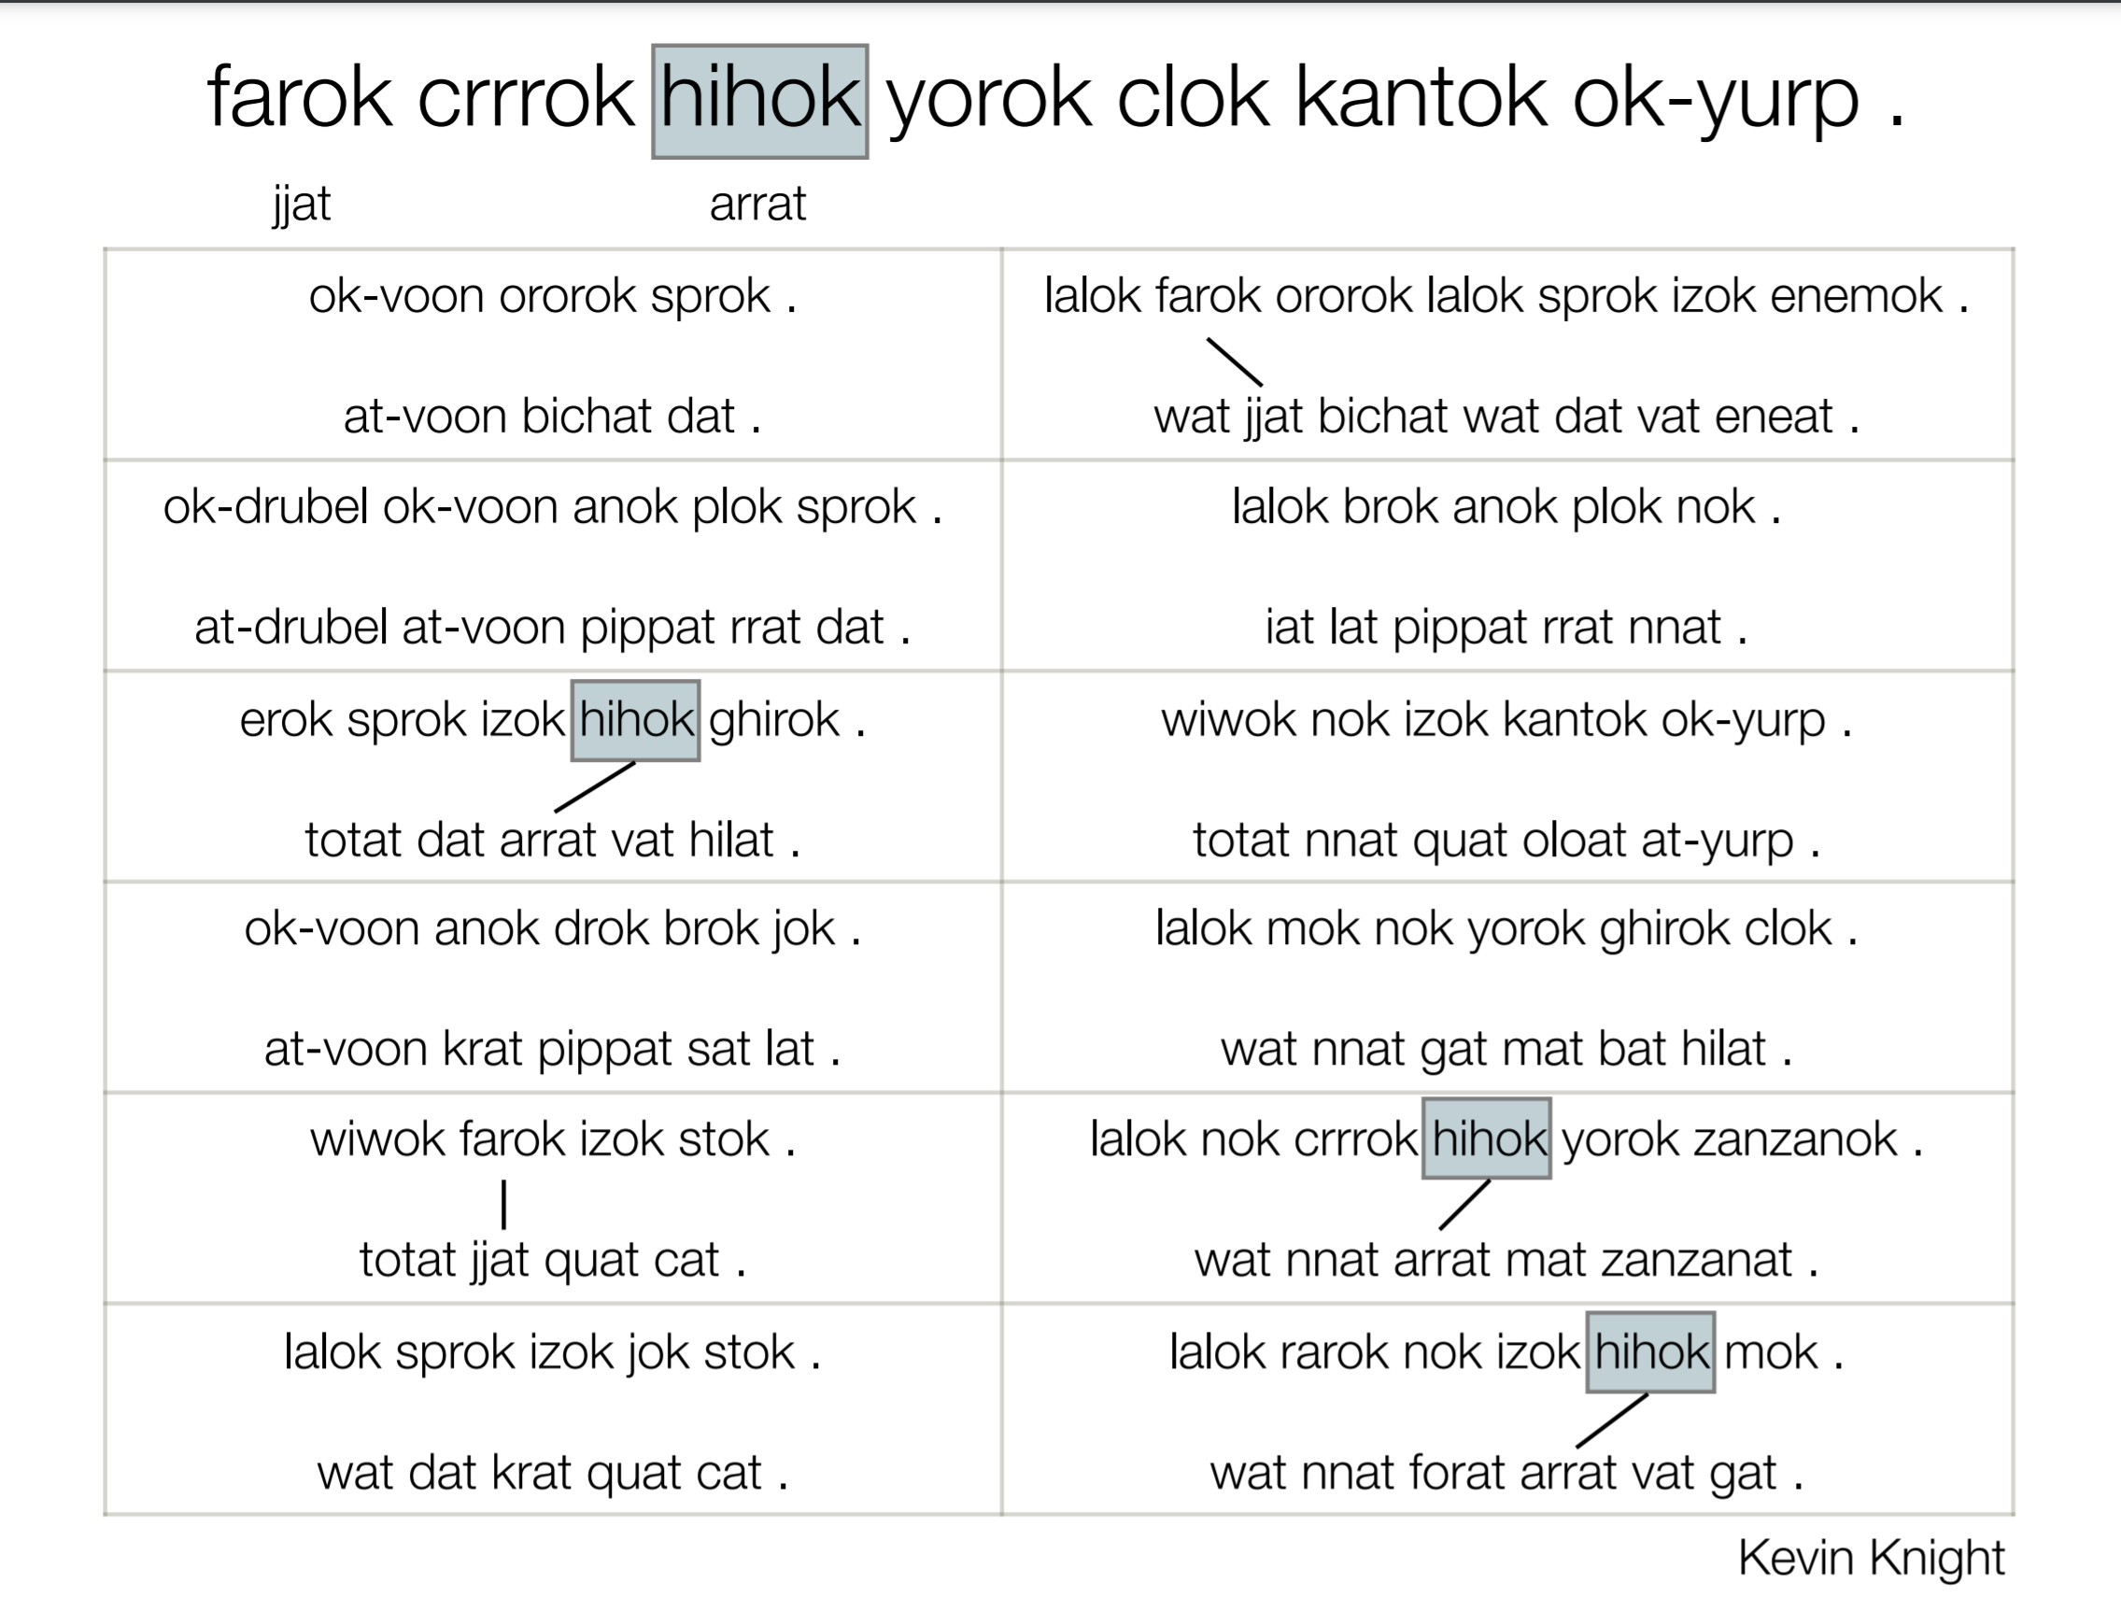

Slide 10
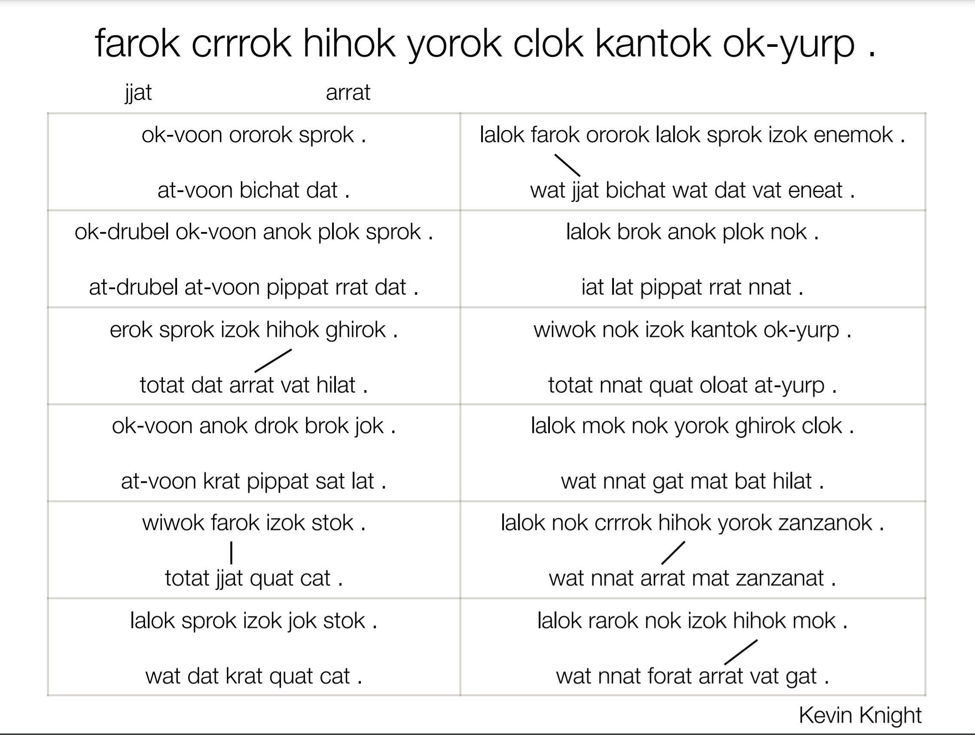

Slide 11
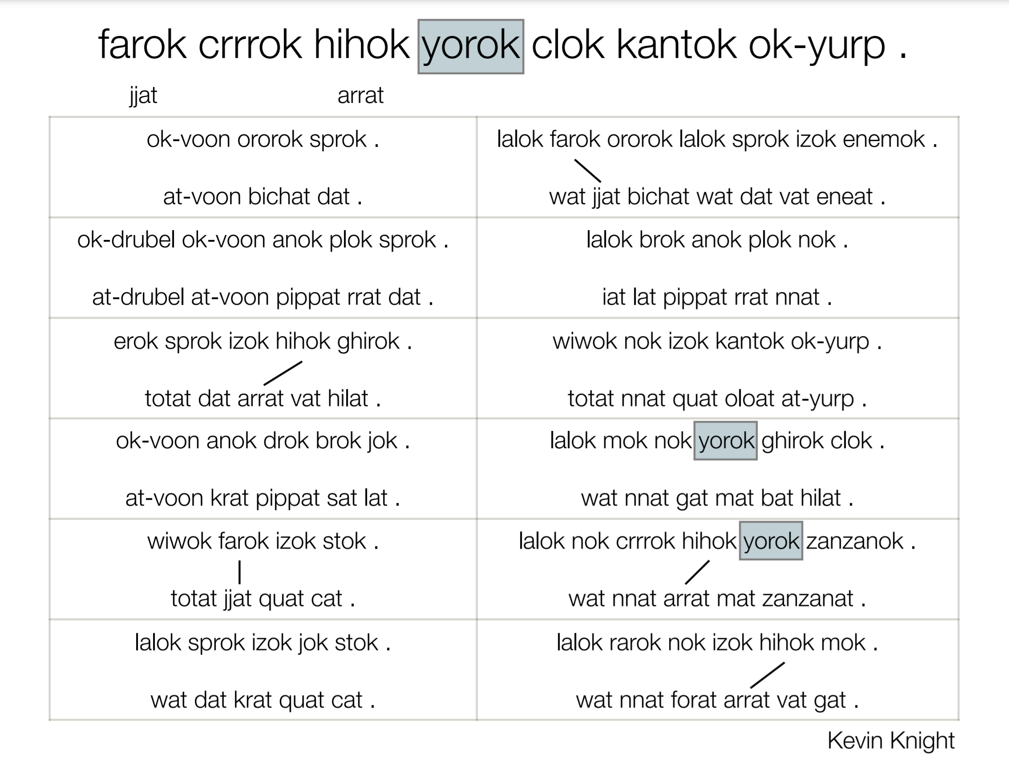

Slide 12
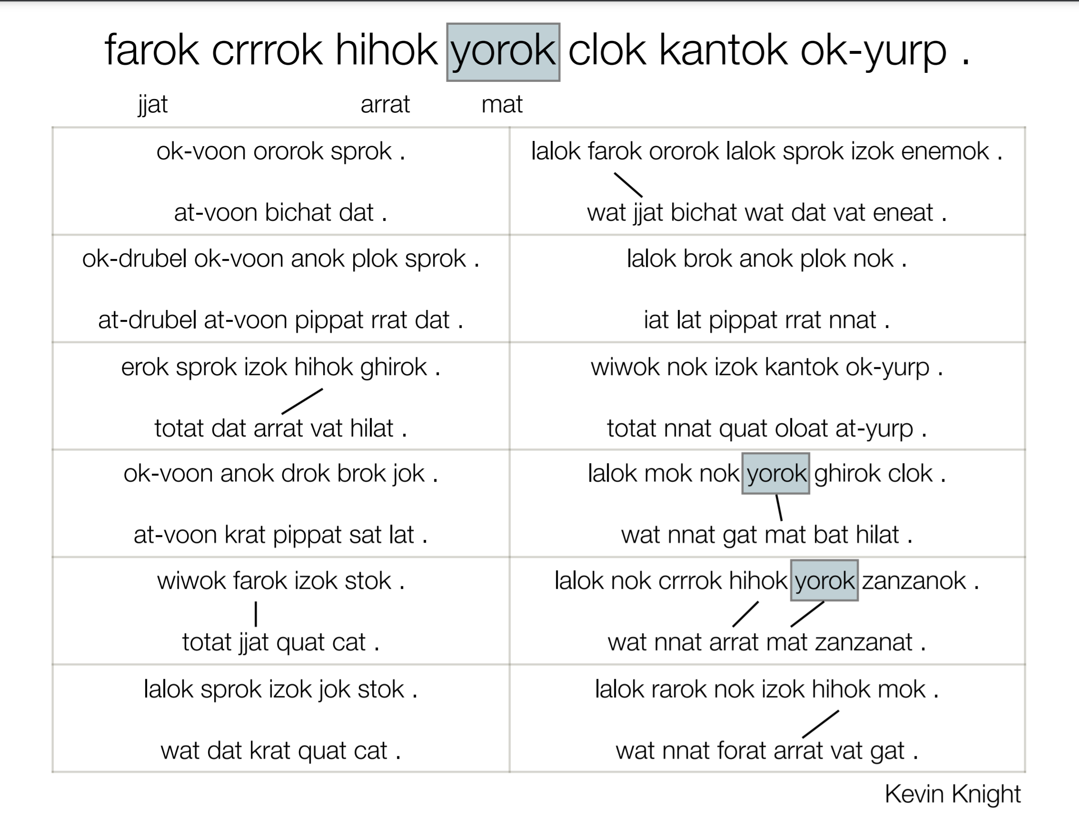

Slide 13
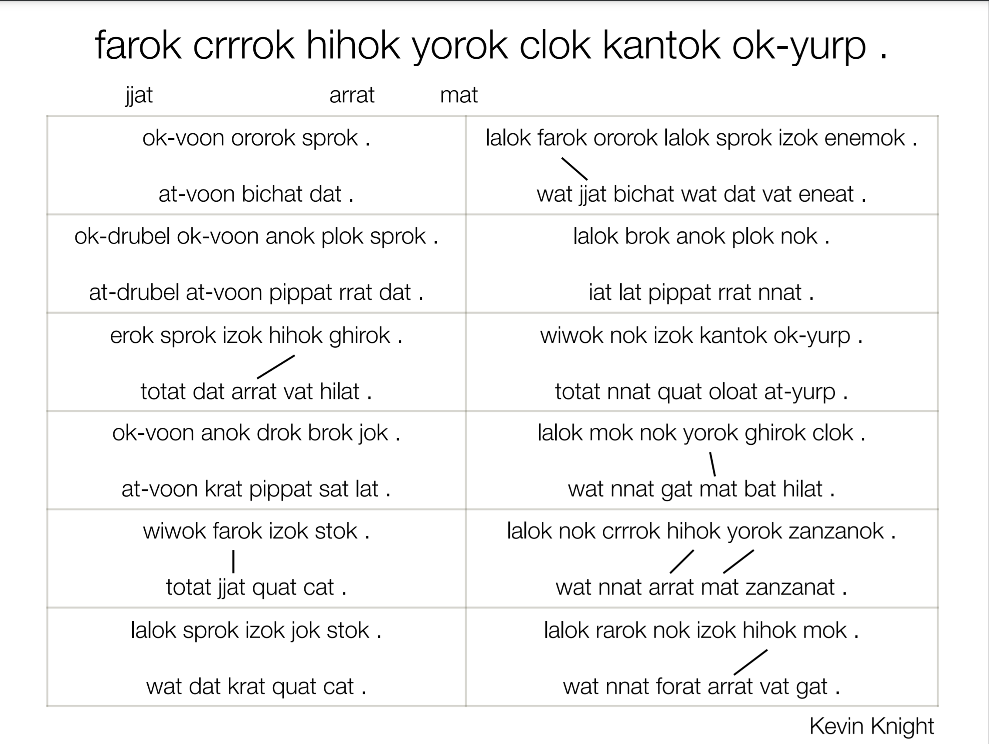

Slide 14
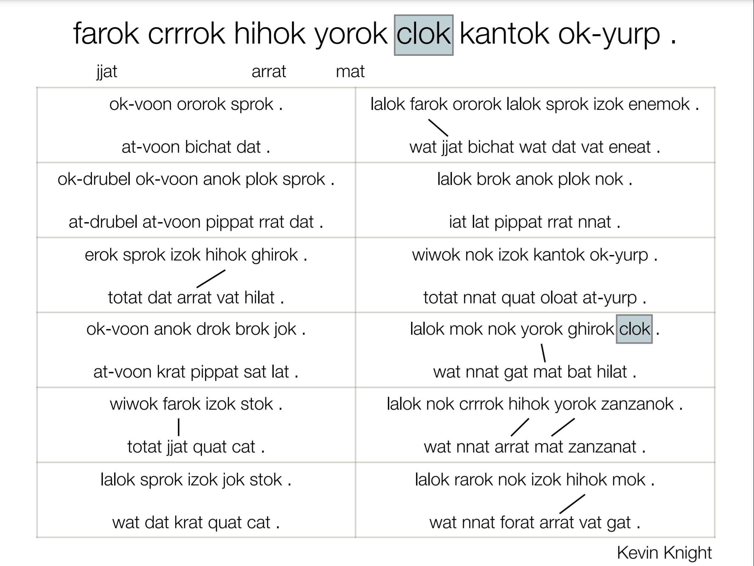

Slide 15


Slide 16
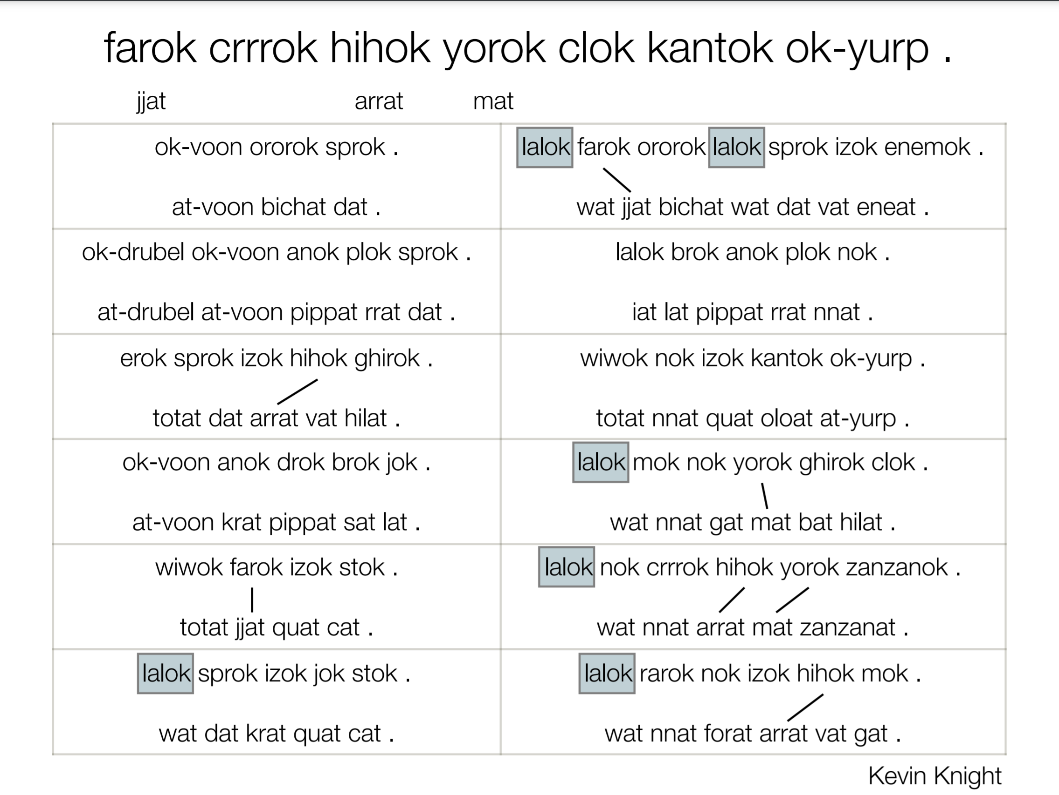

Slide 17
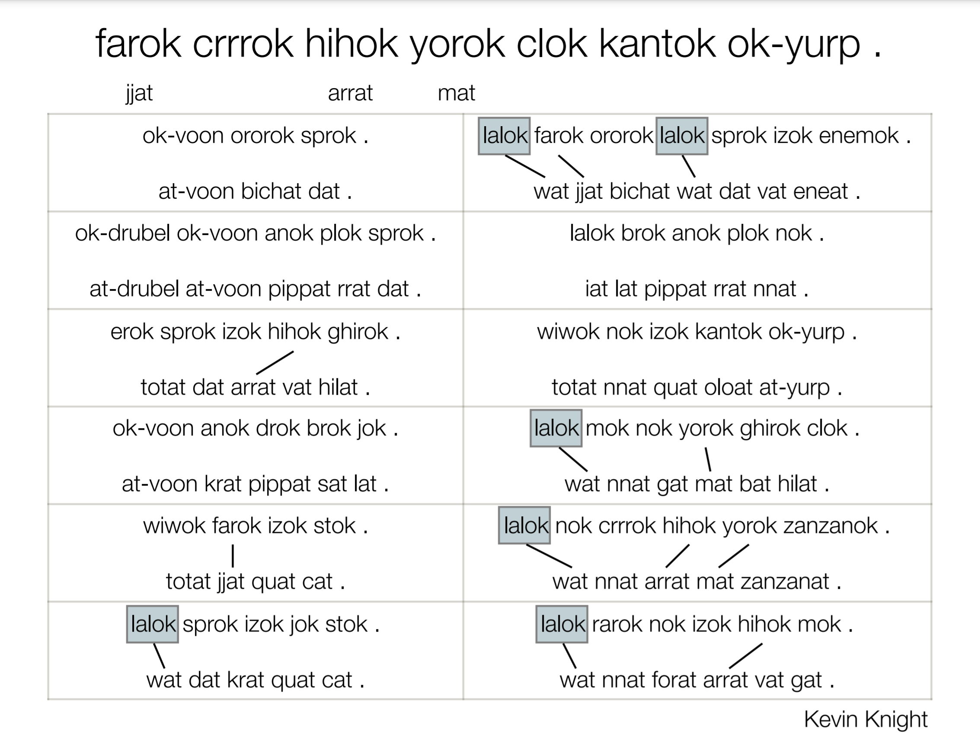

Slide 18
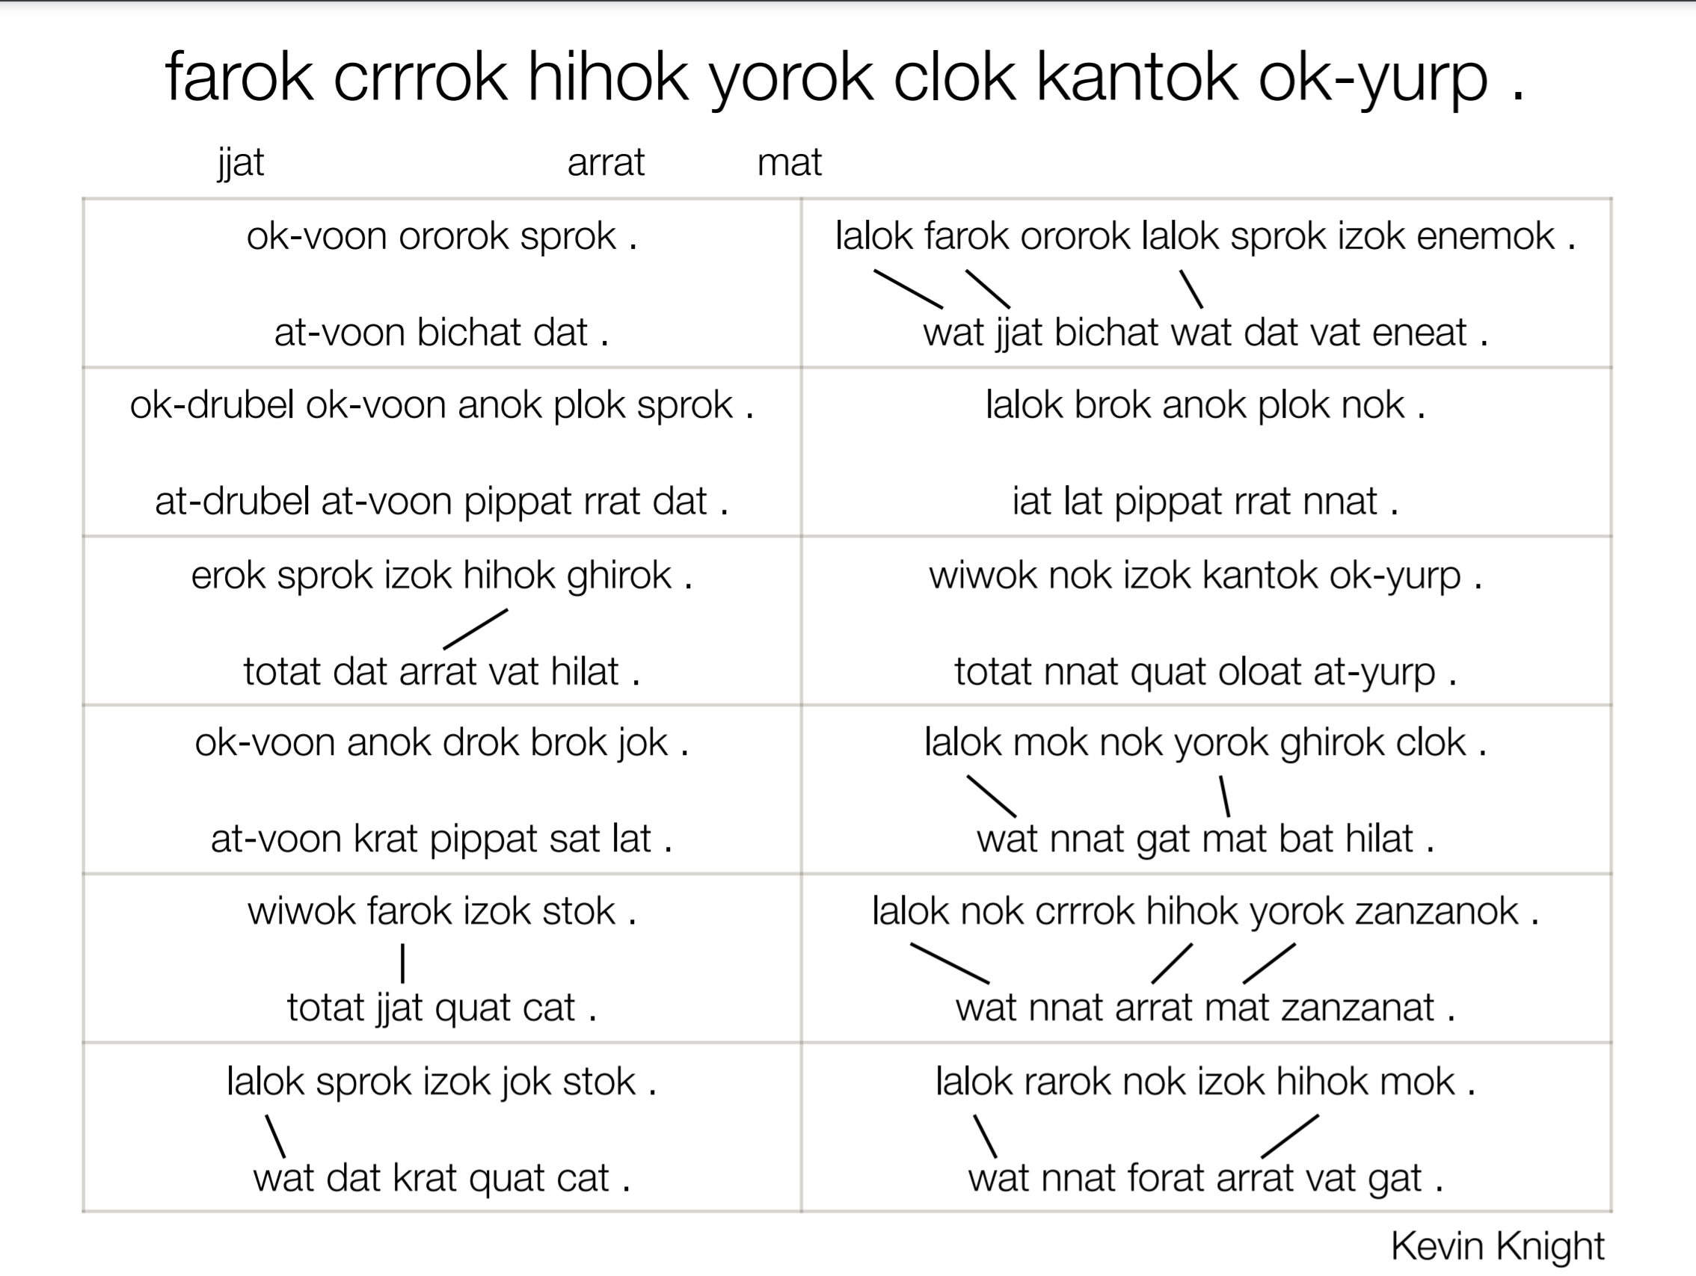

Slide 19
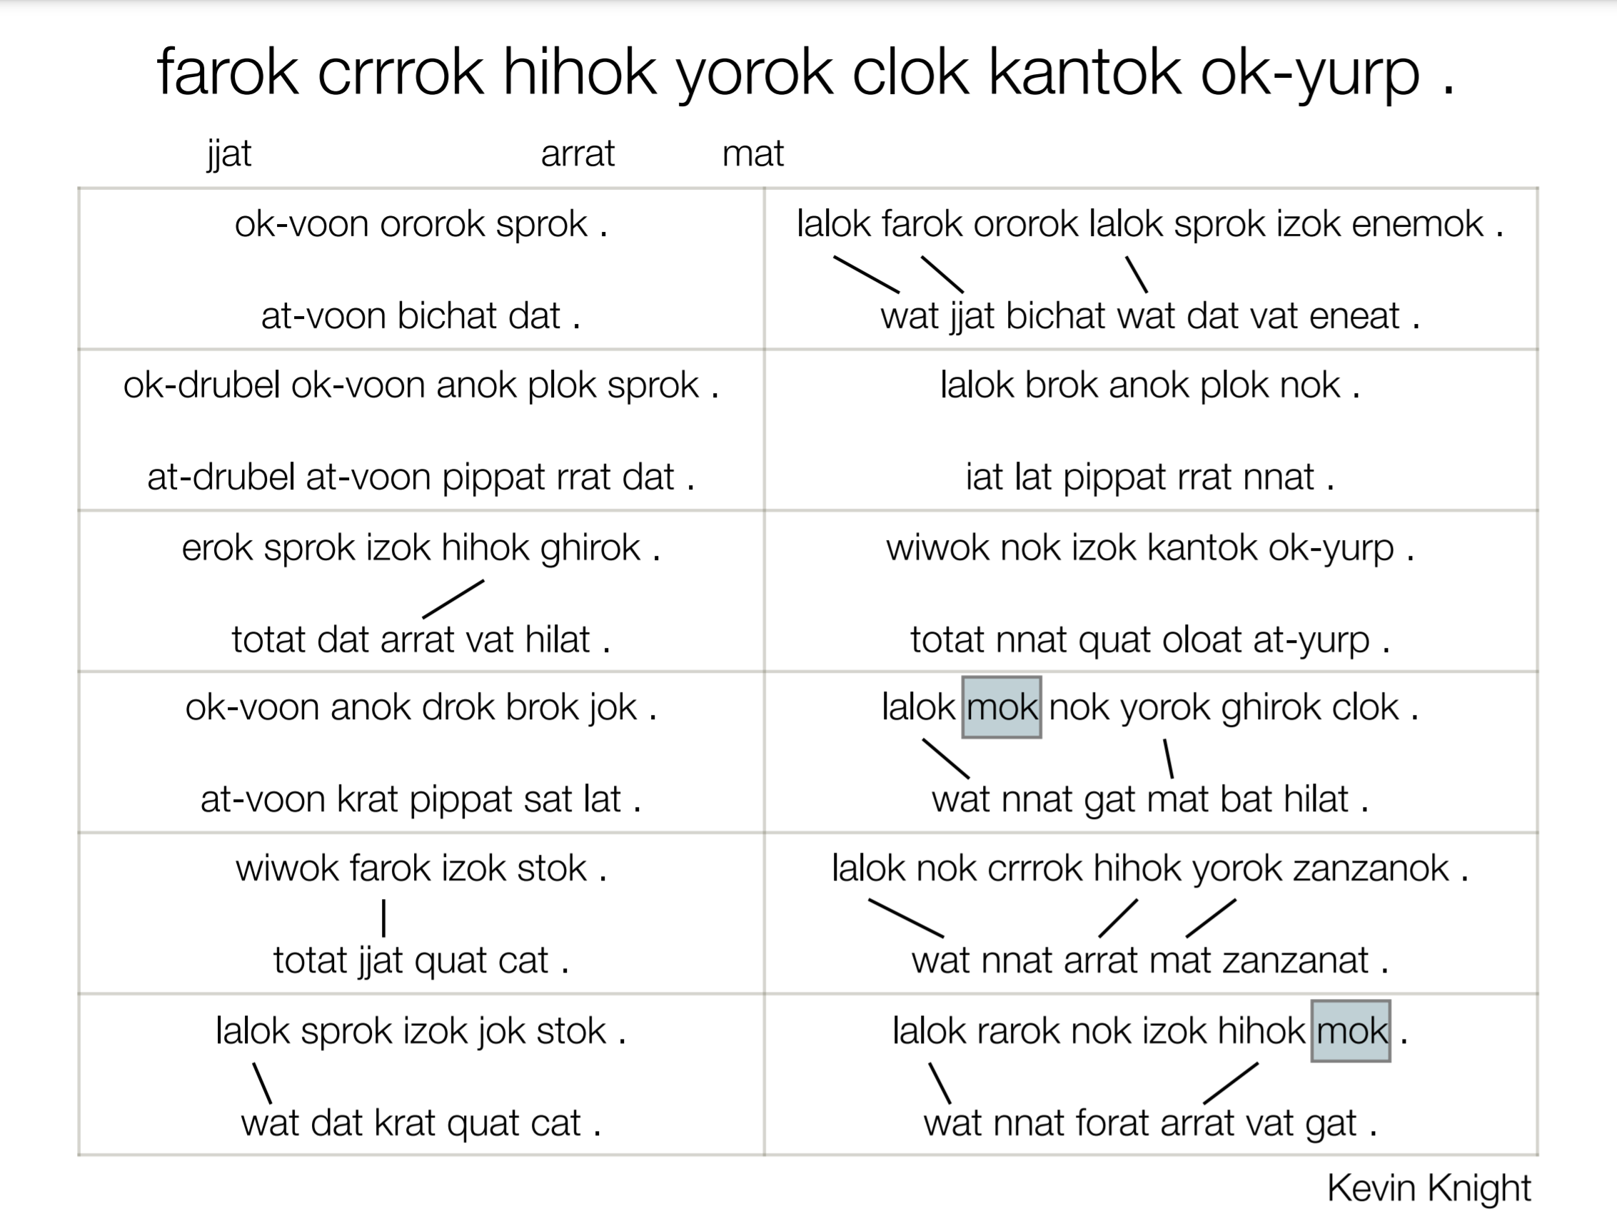

Slide 20
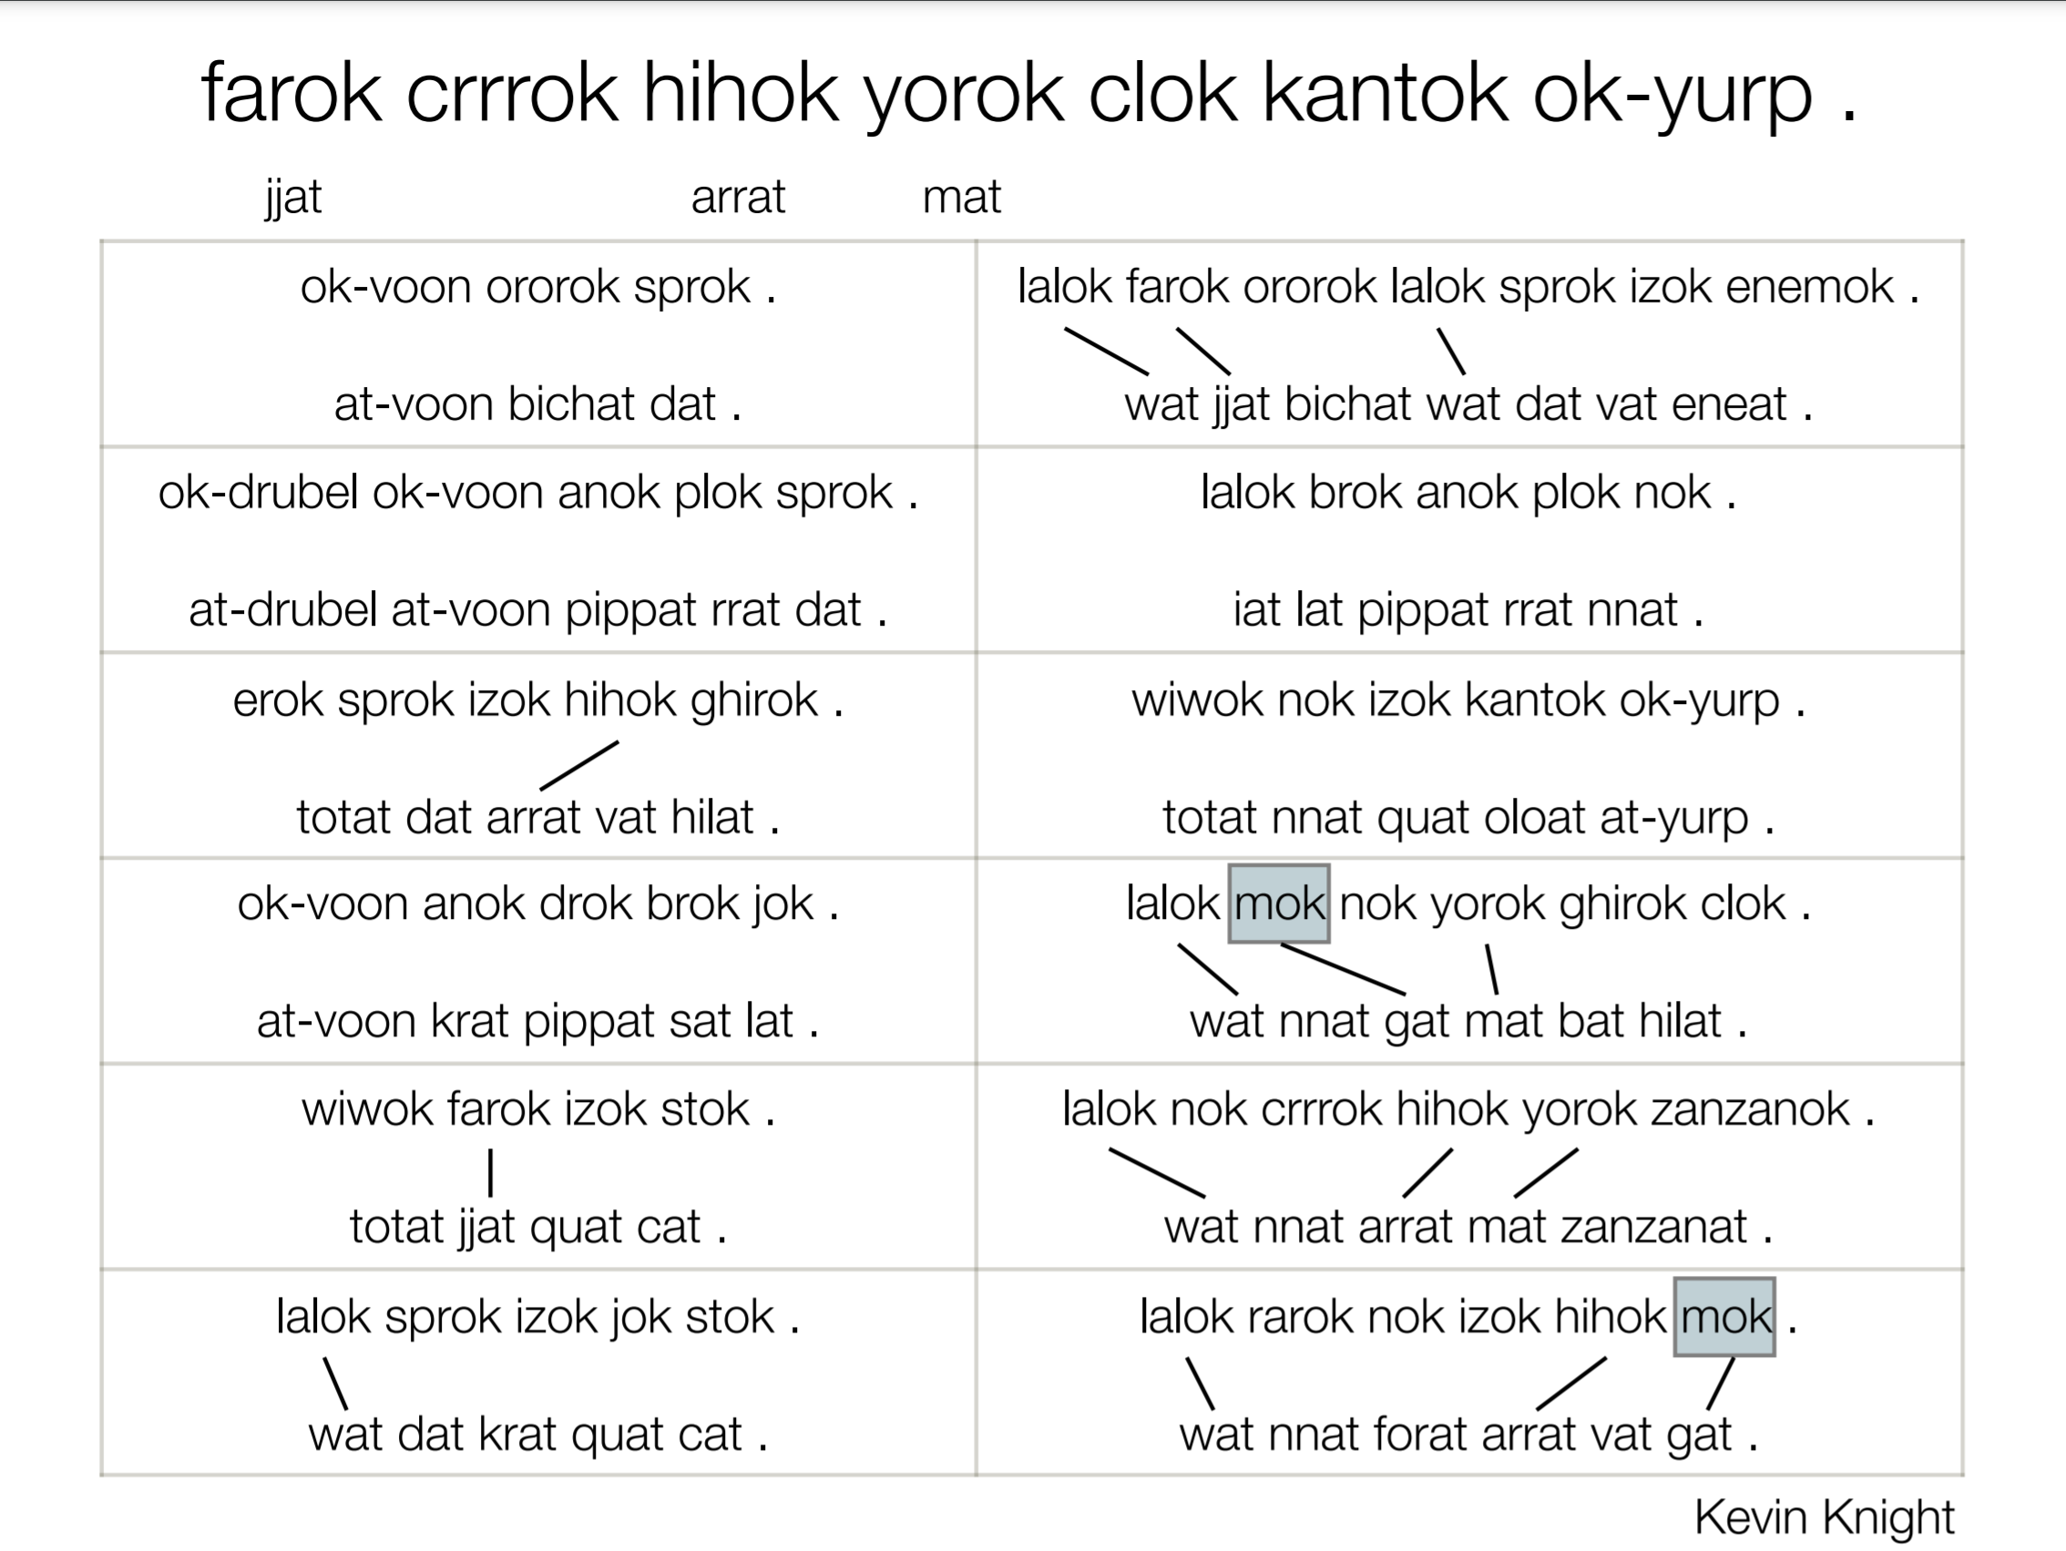

Slide 21
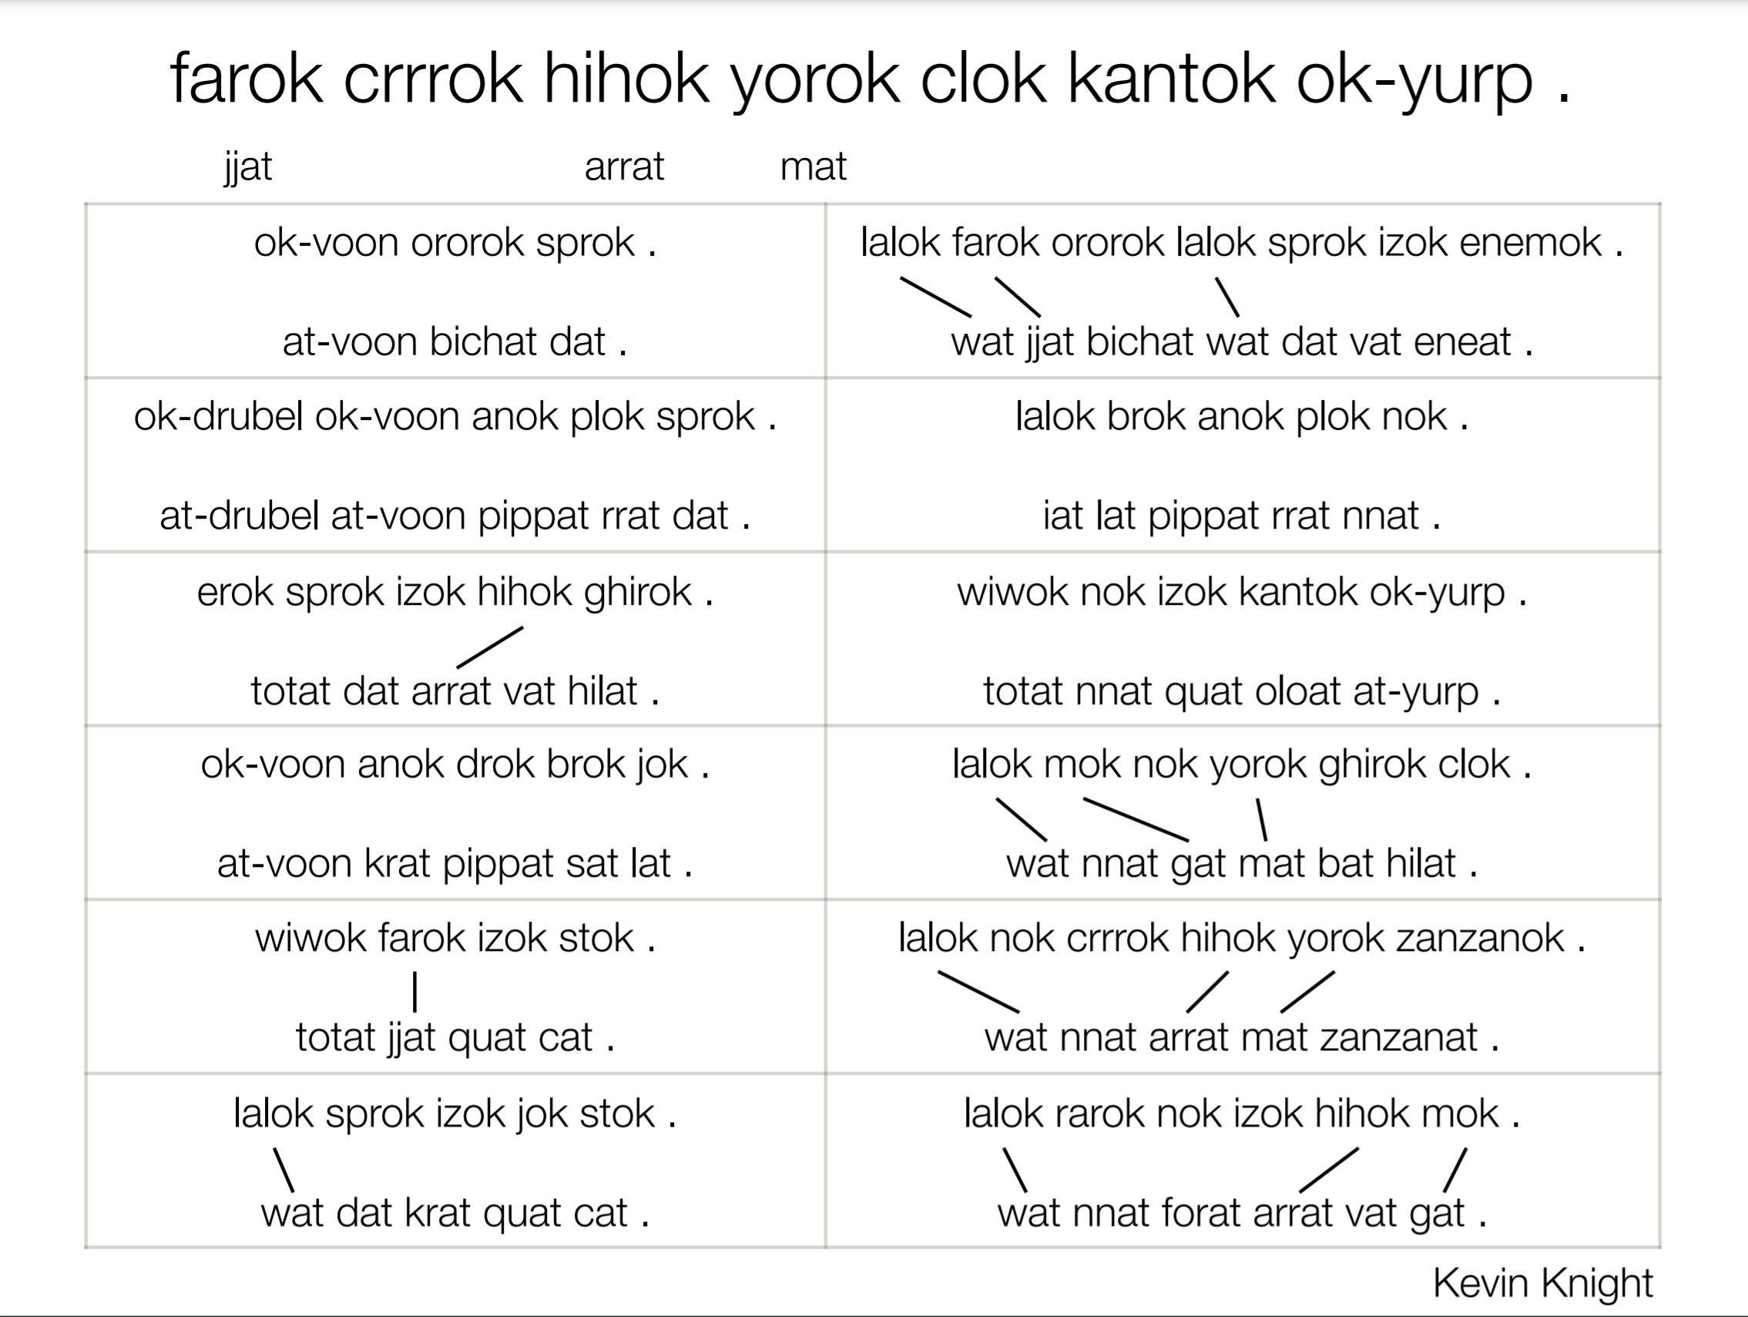

Slide 22
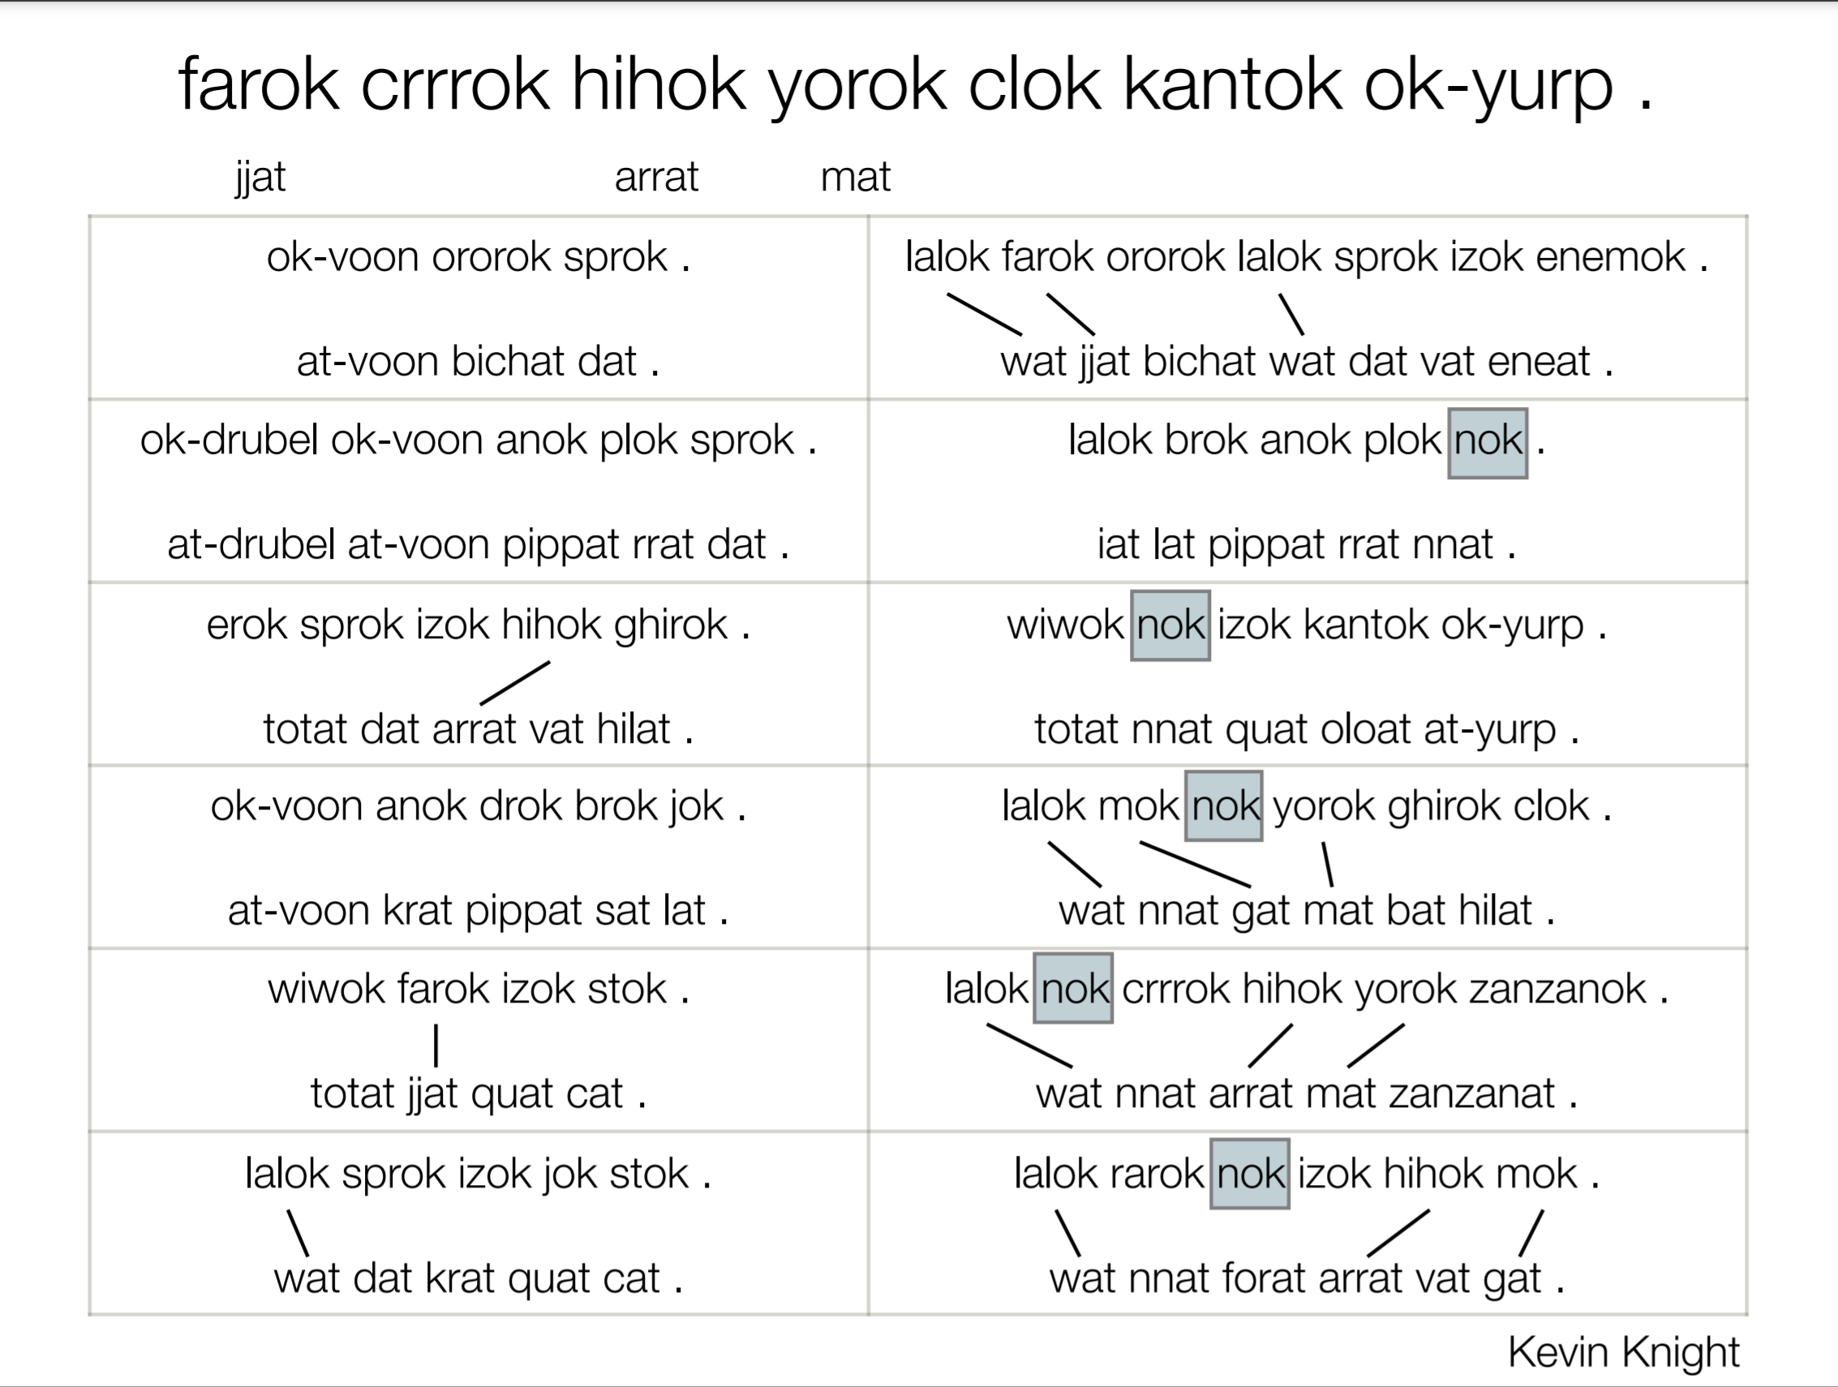

Slide 23
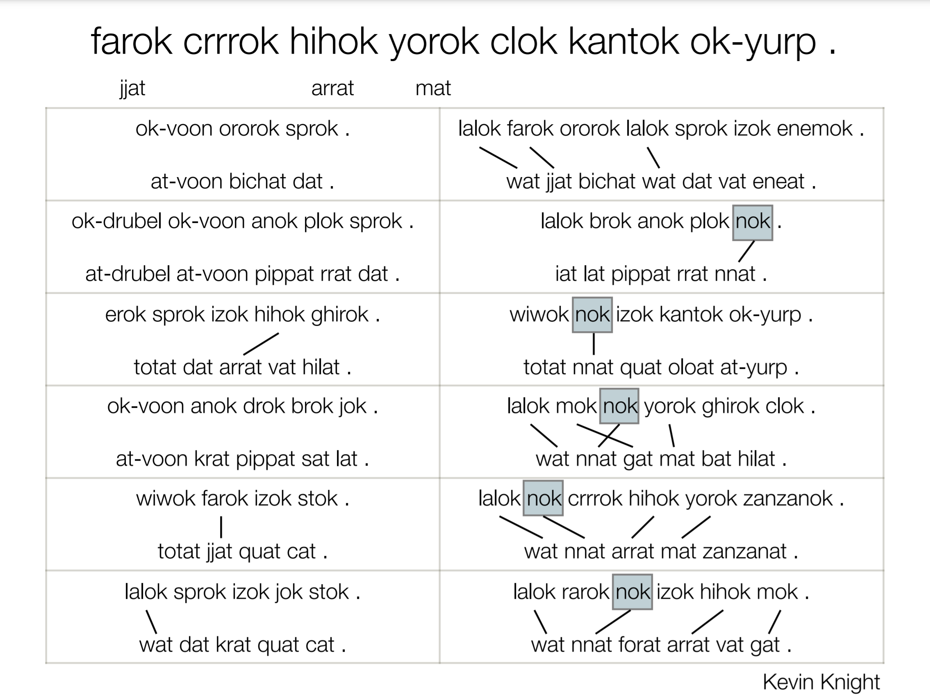

Slide 24
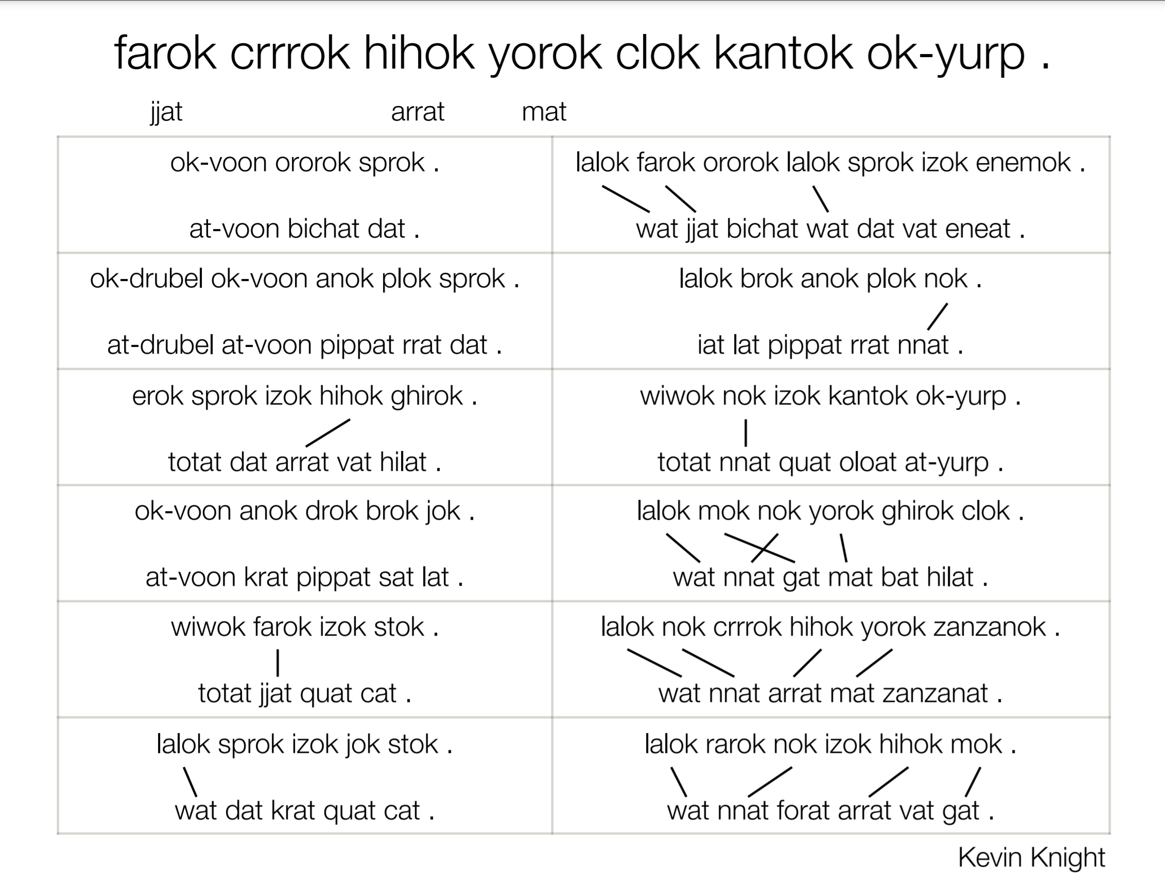

Slide 25
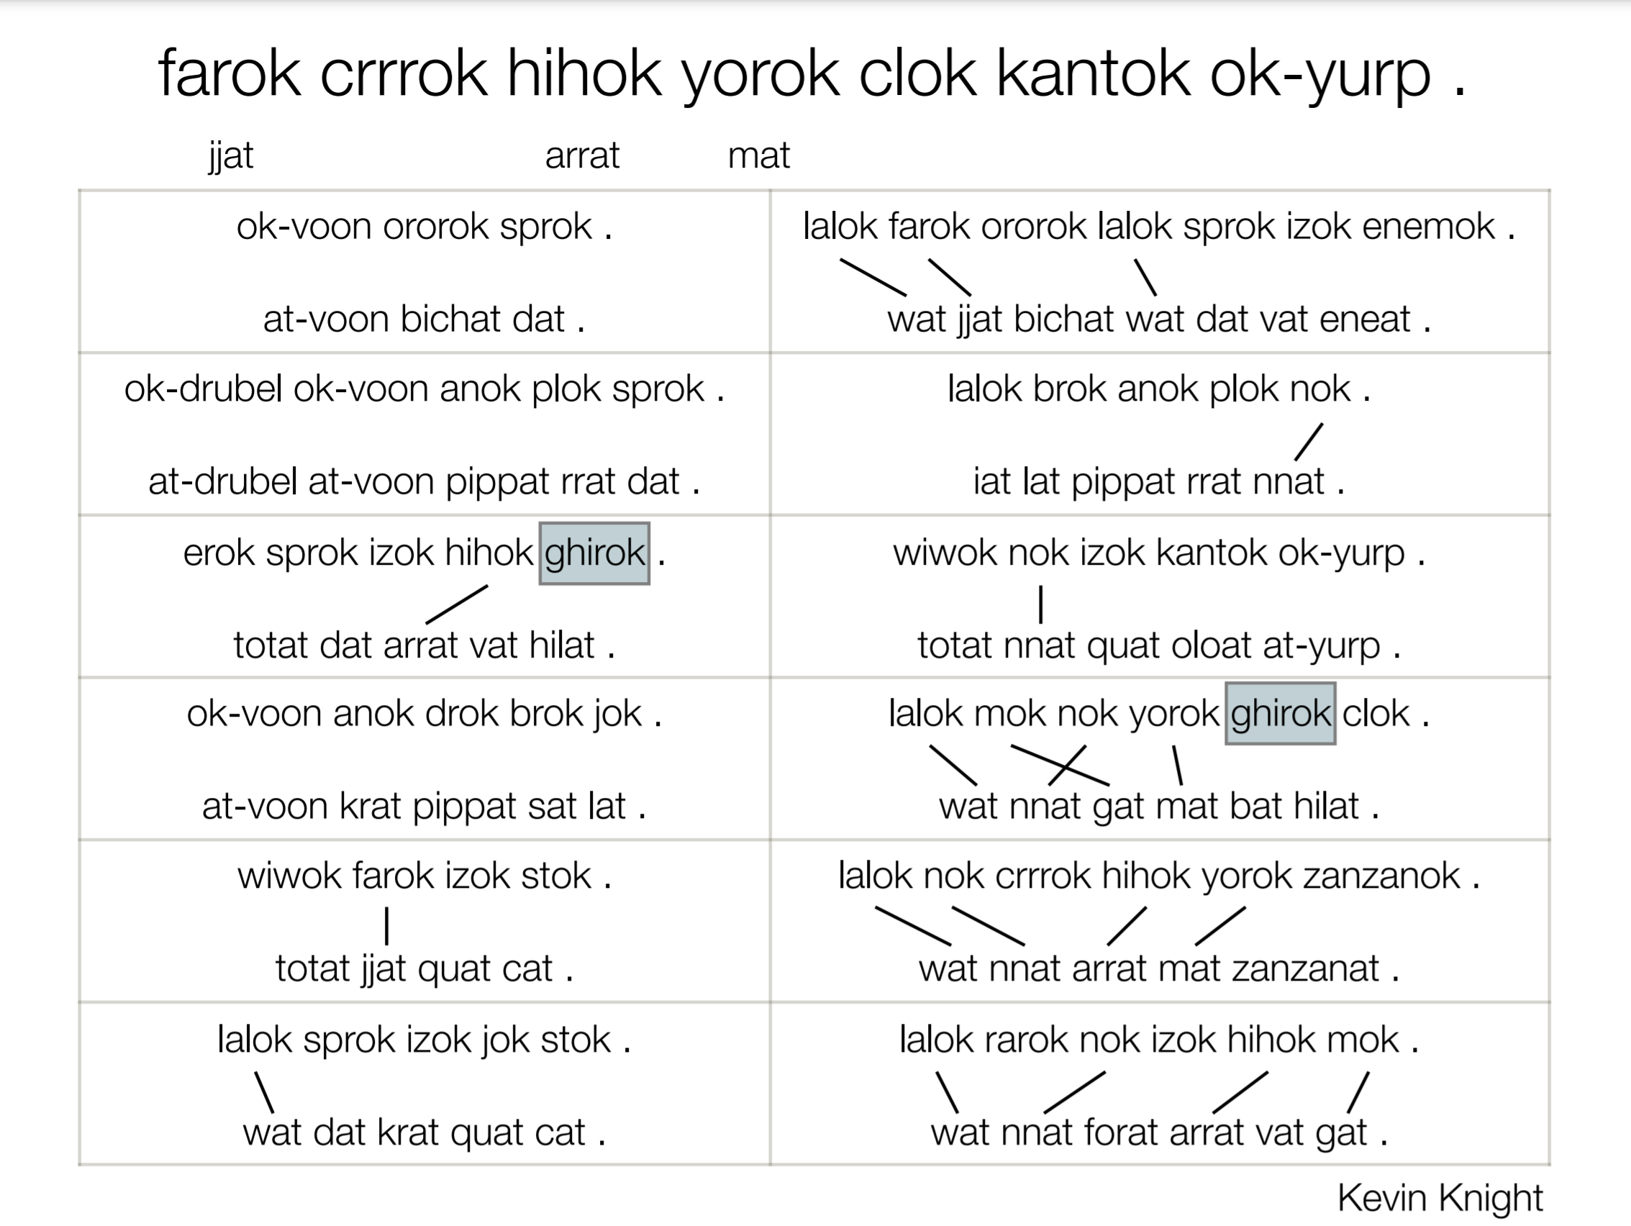

Slide 26
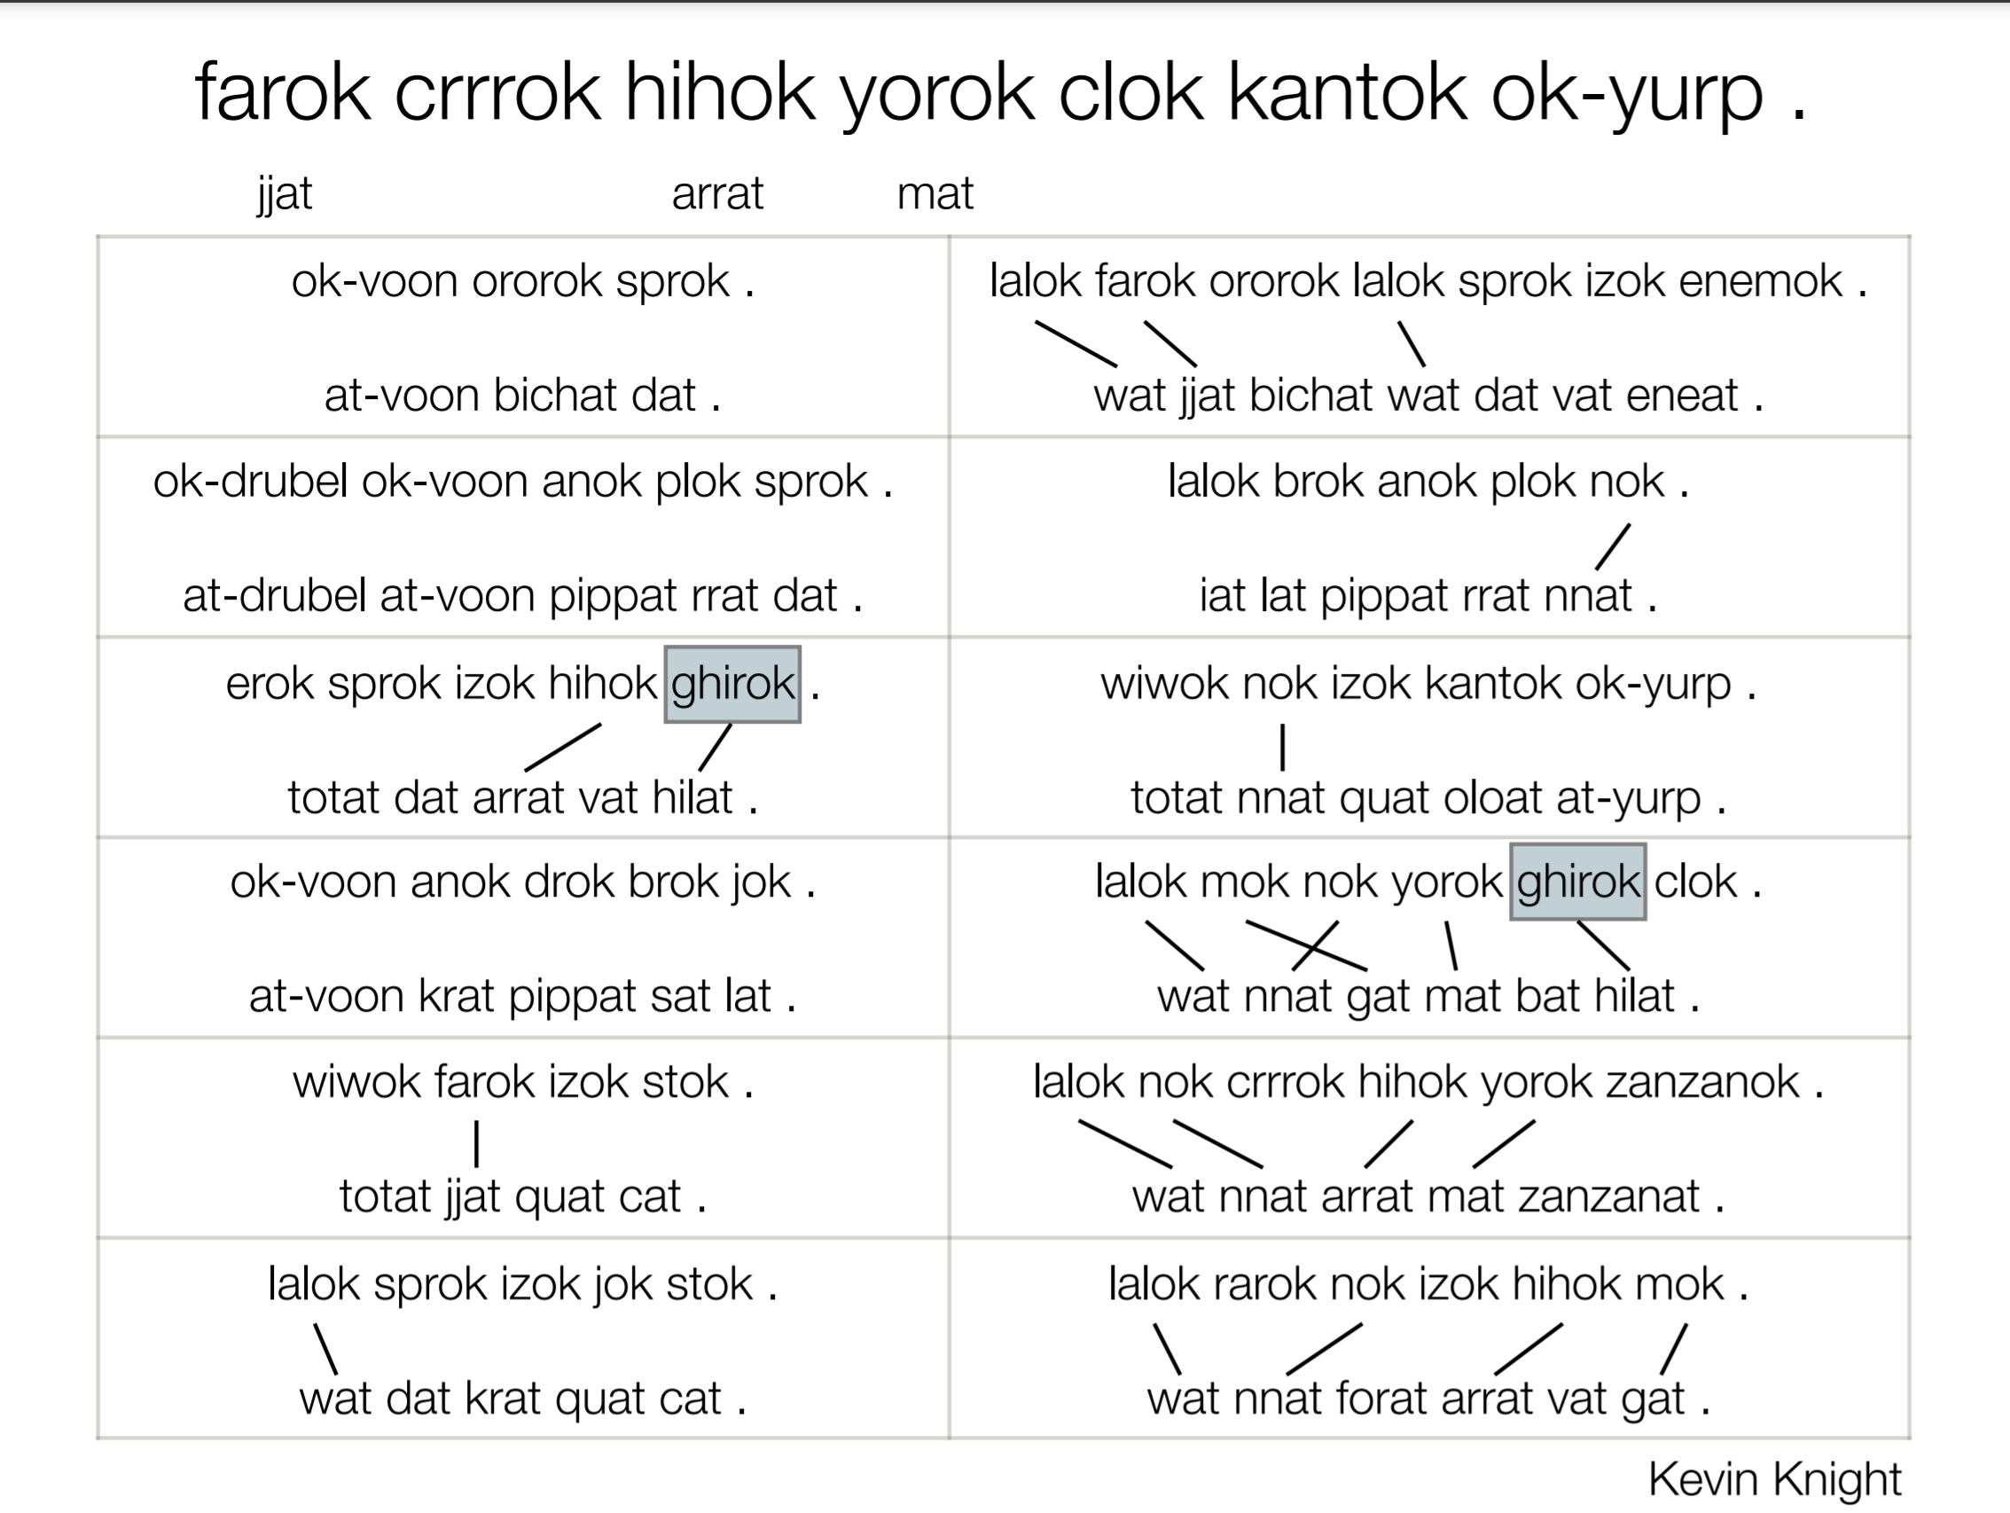

Slide 27
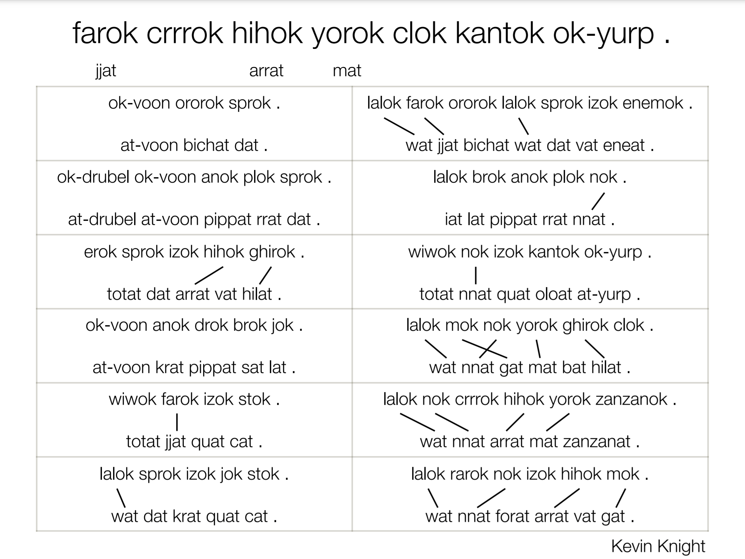

Slide 28
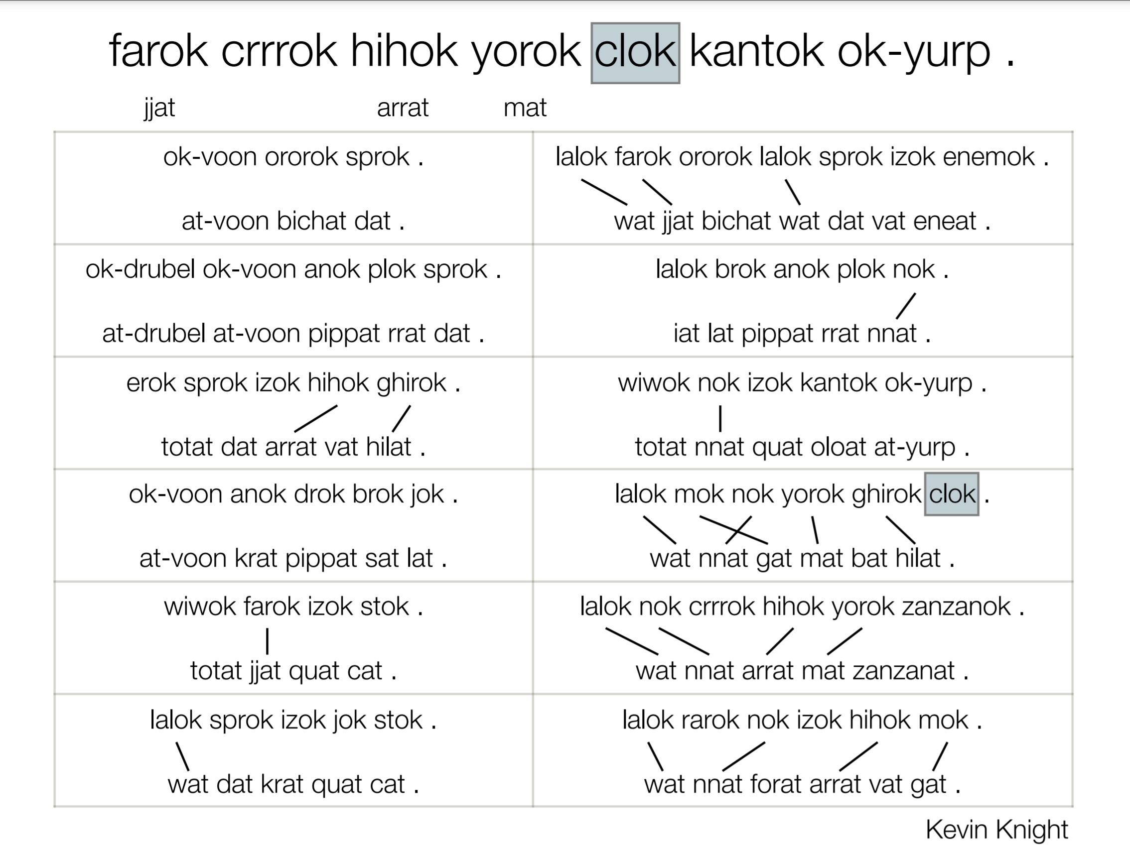

Slide 29
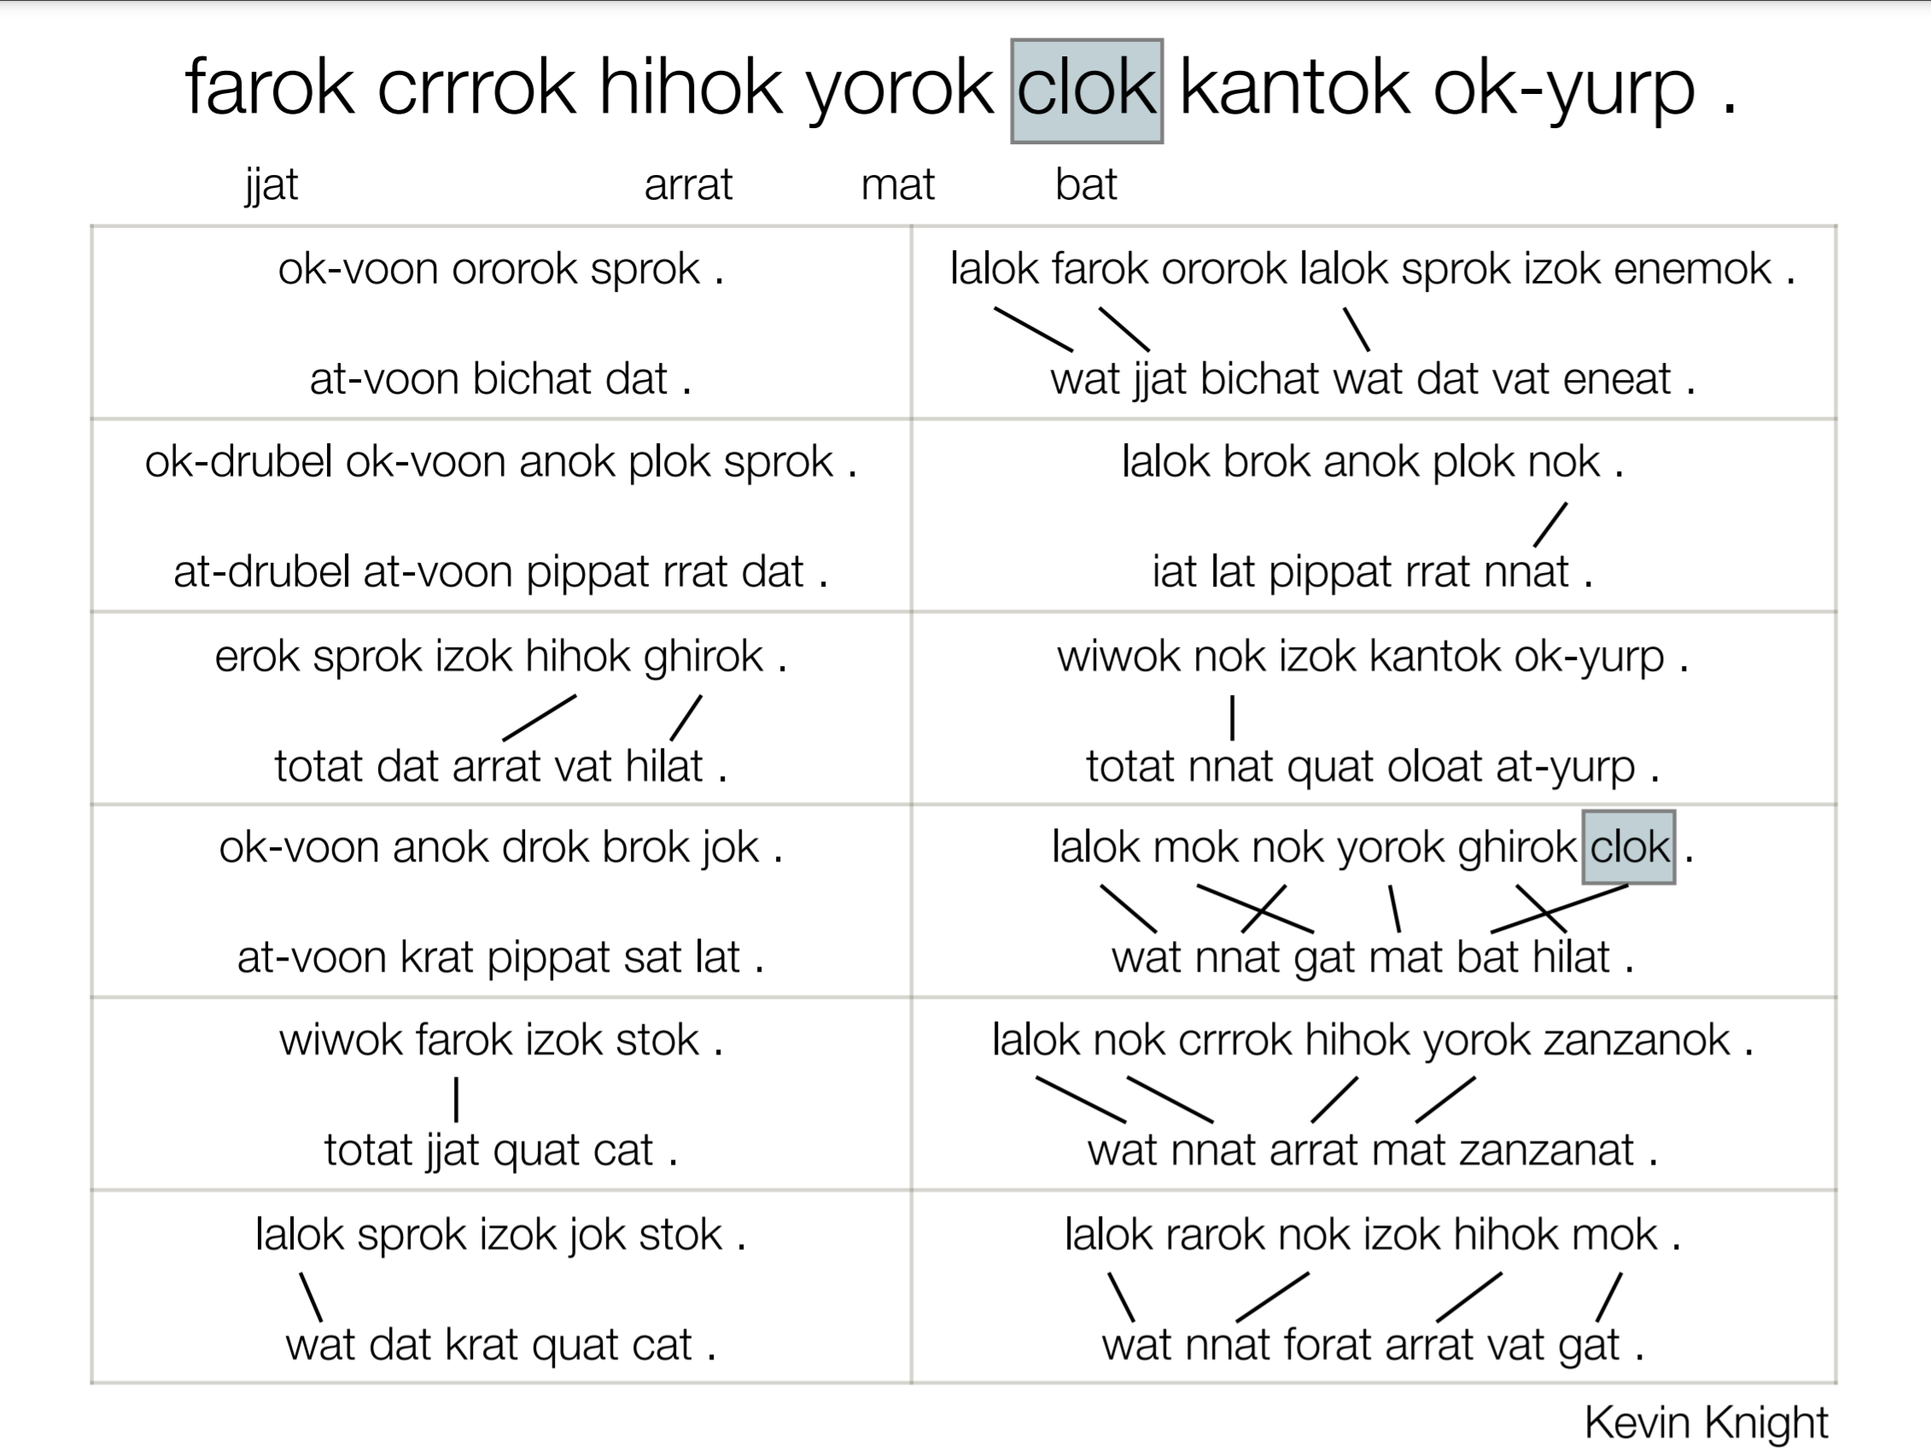

Slide 30
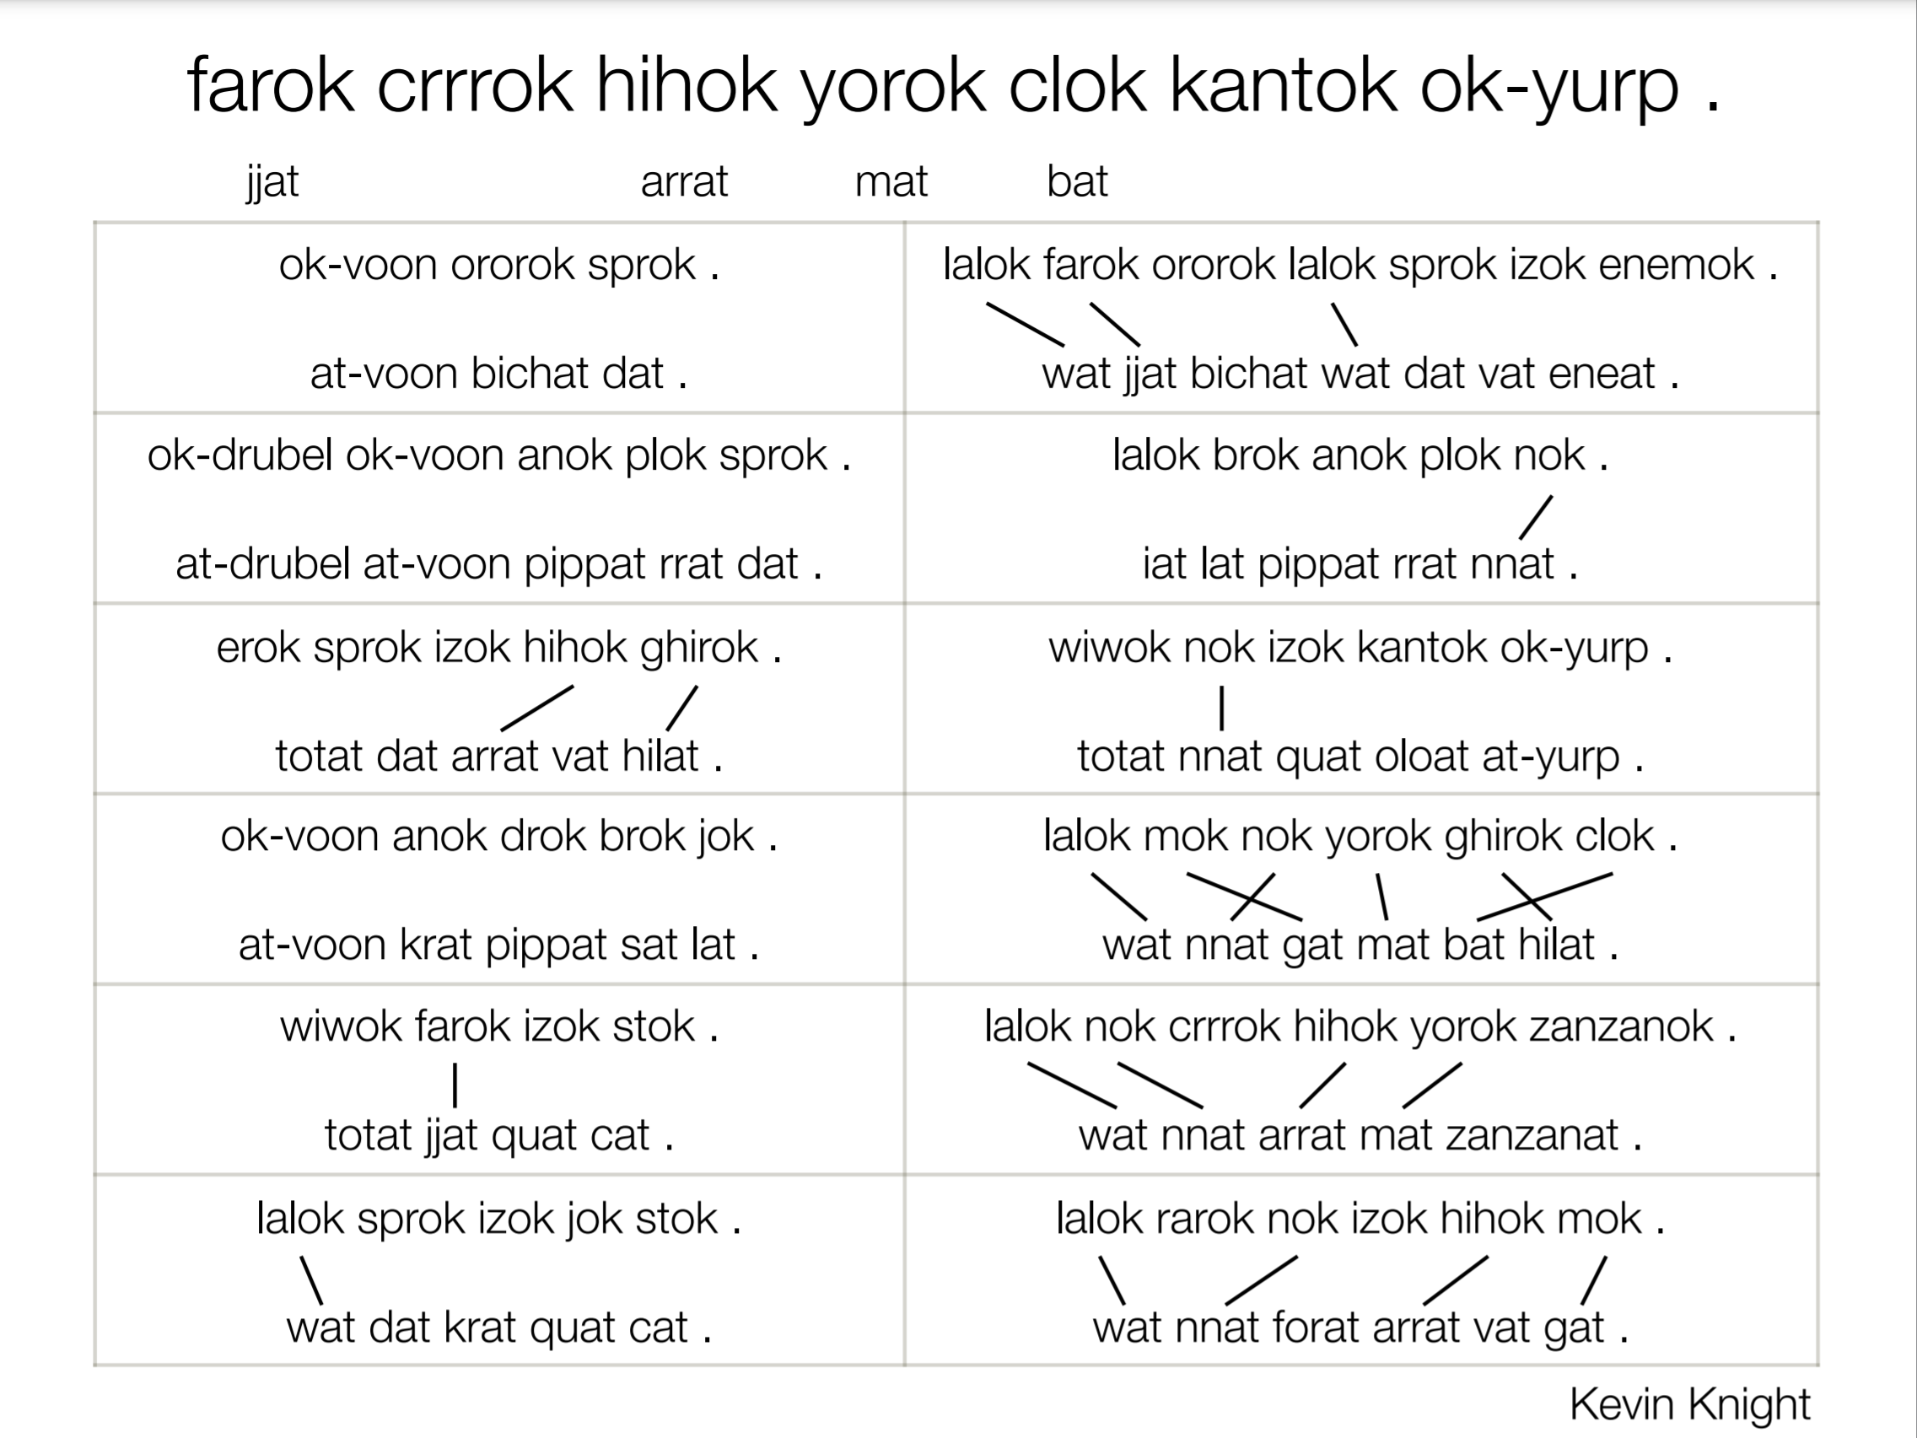

Slide 31
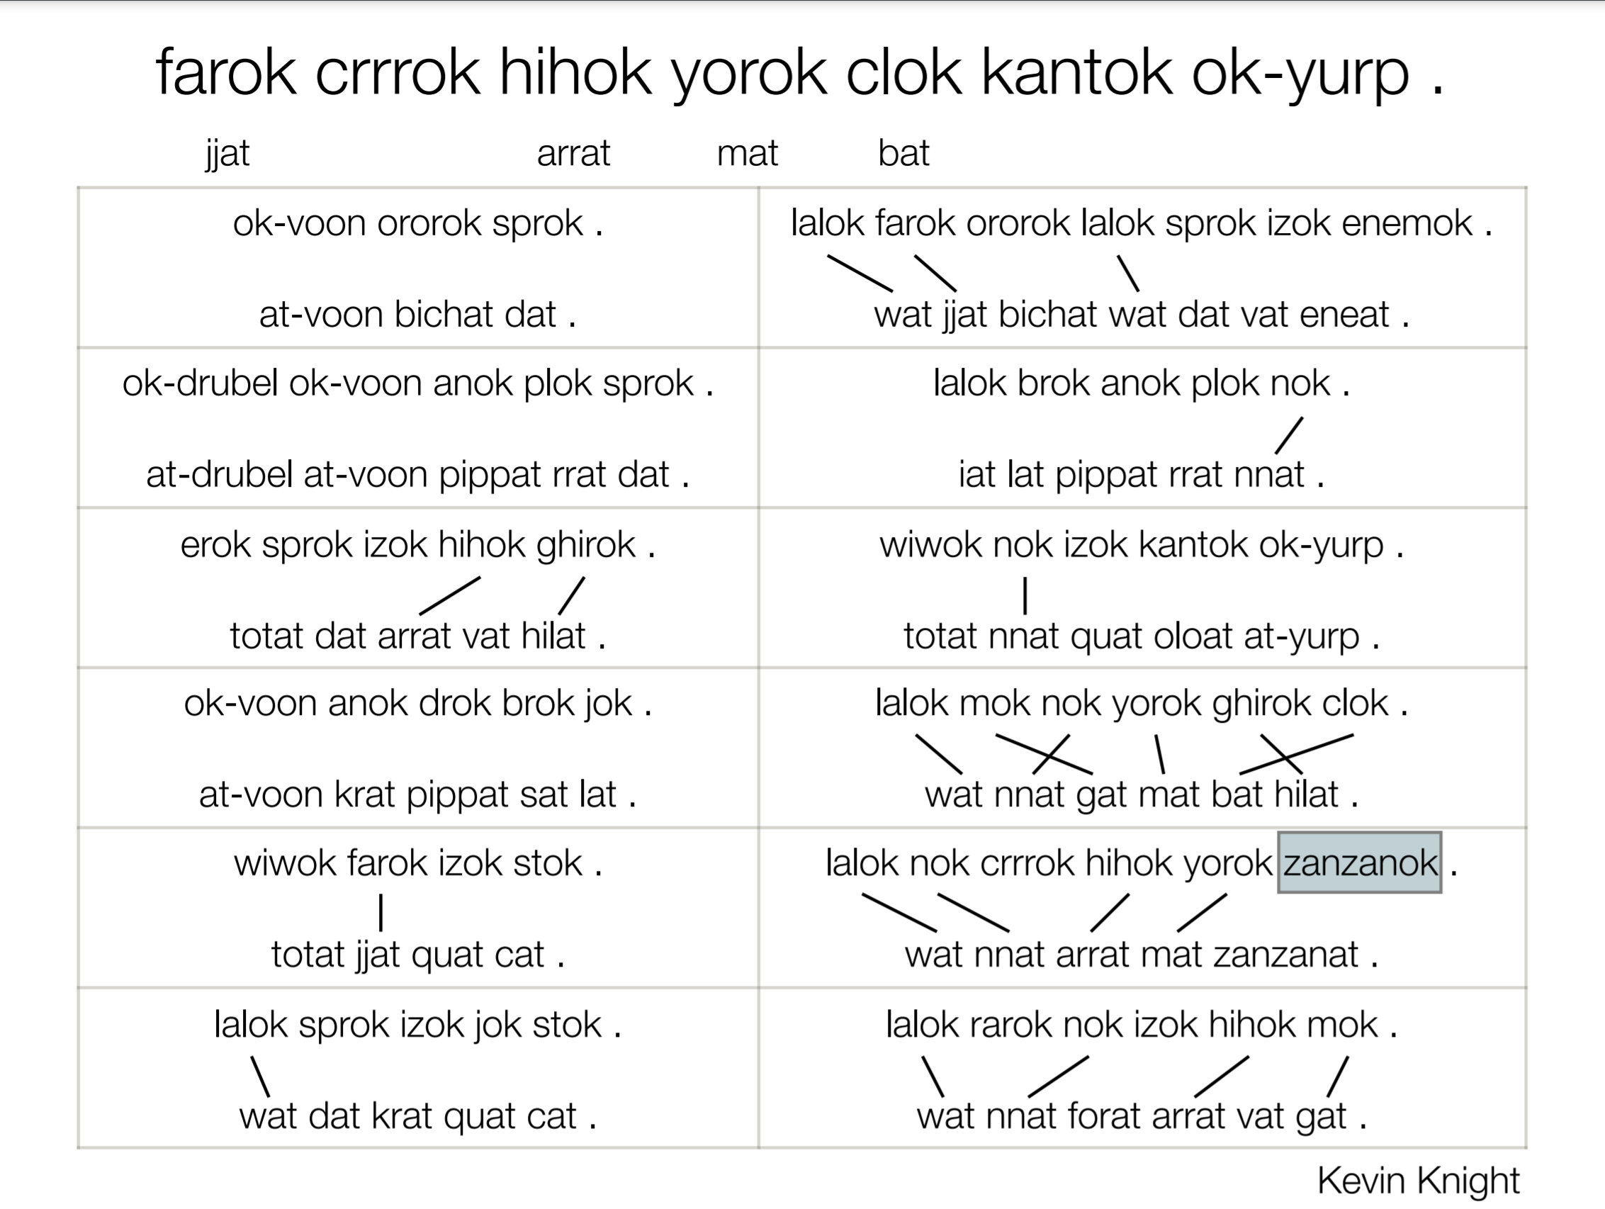

Slide 32


Slide 33


Slide 34
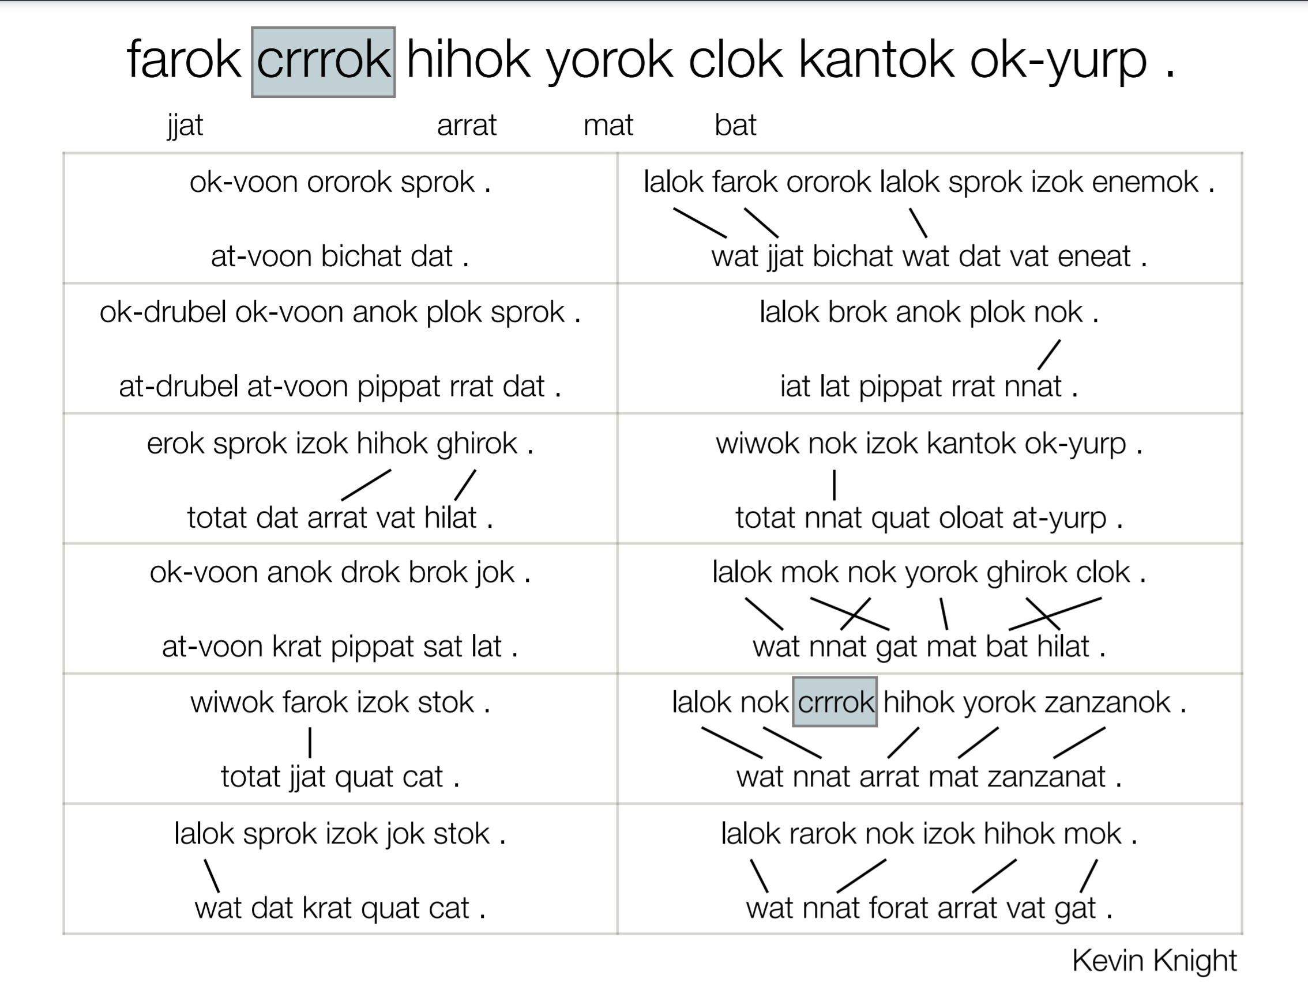

Slide 35


Slide 36
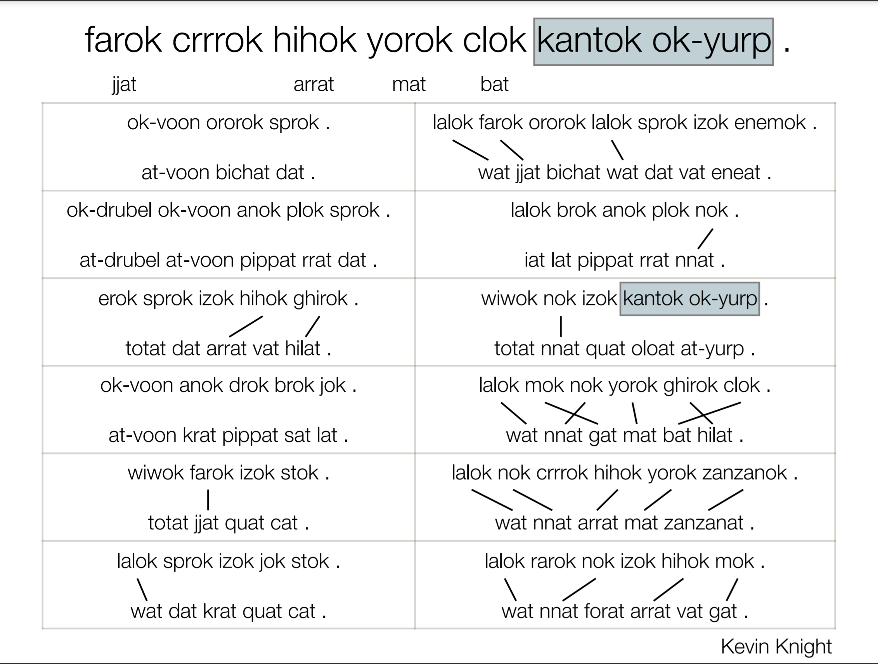

Slide 37
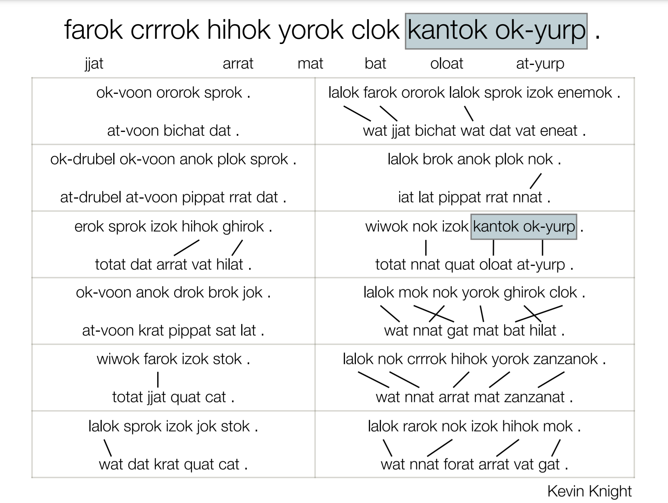

Slide 38
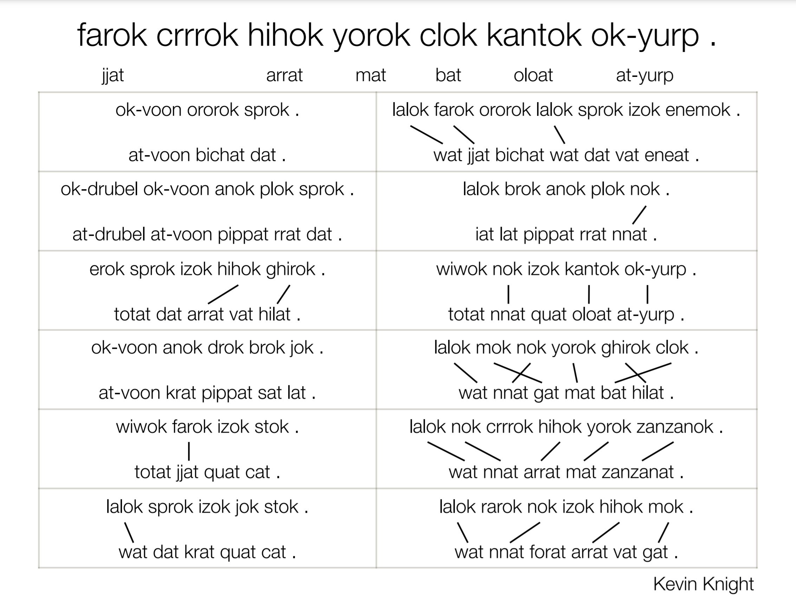

Slide 39
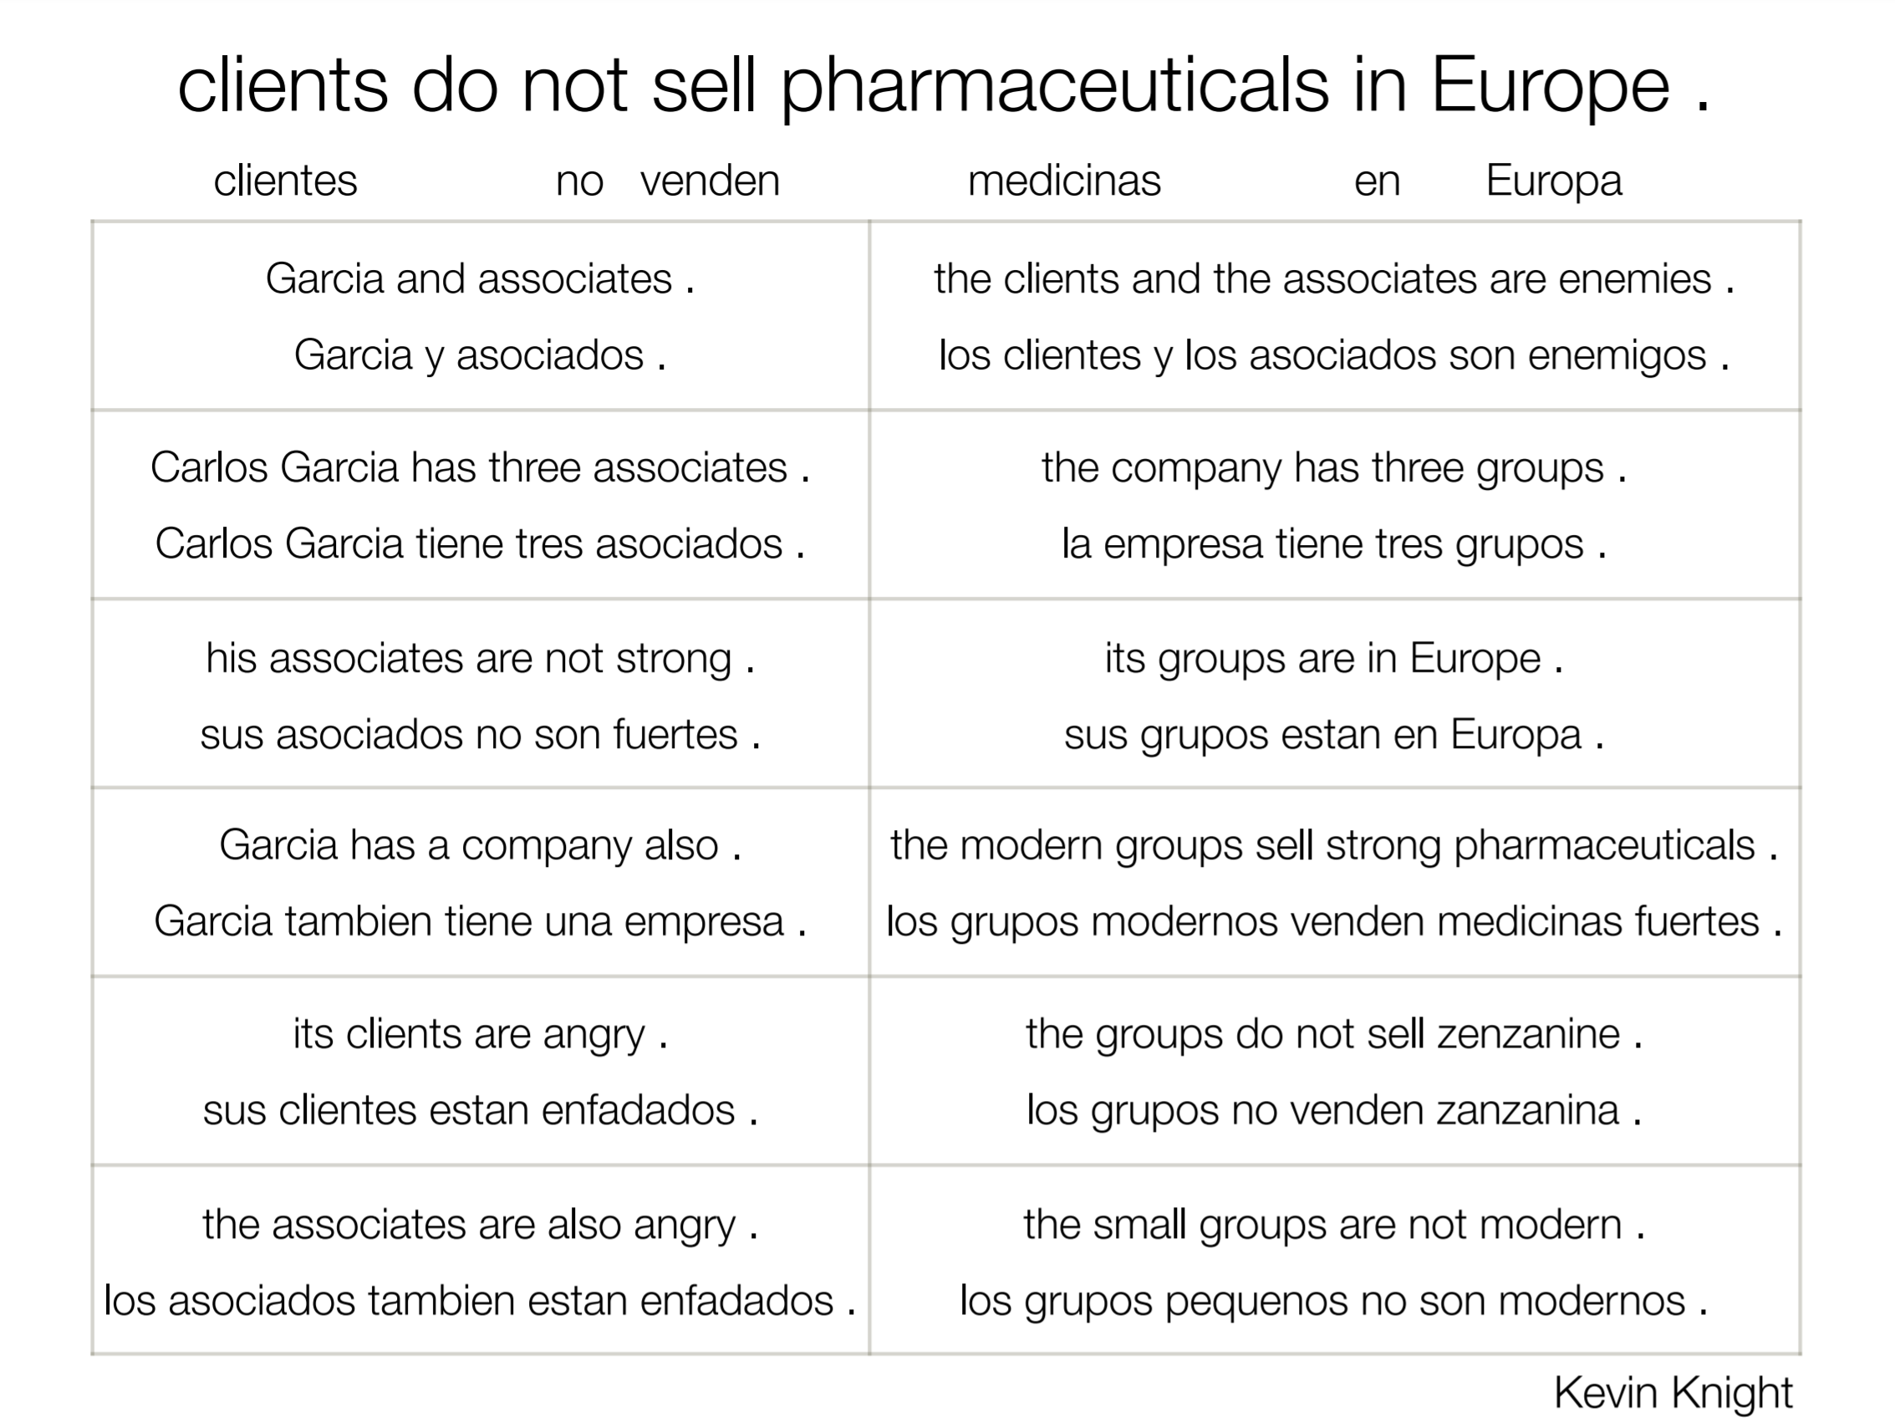

Slide 40
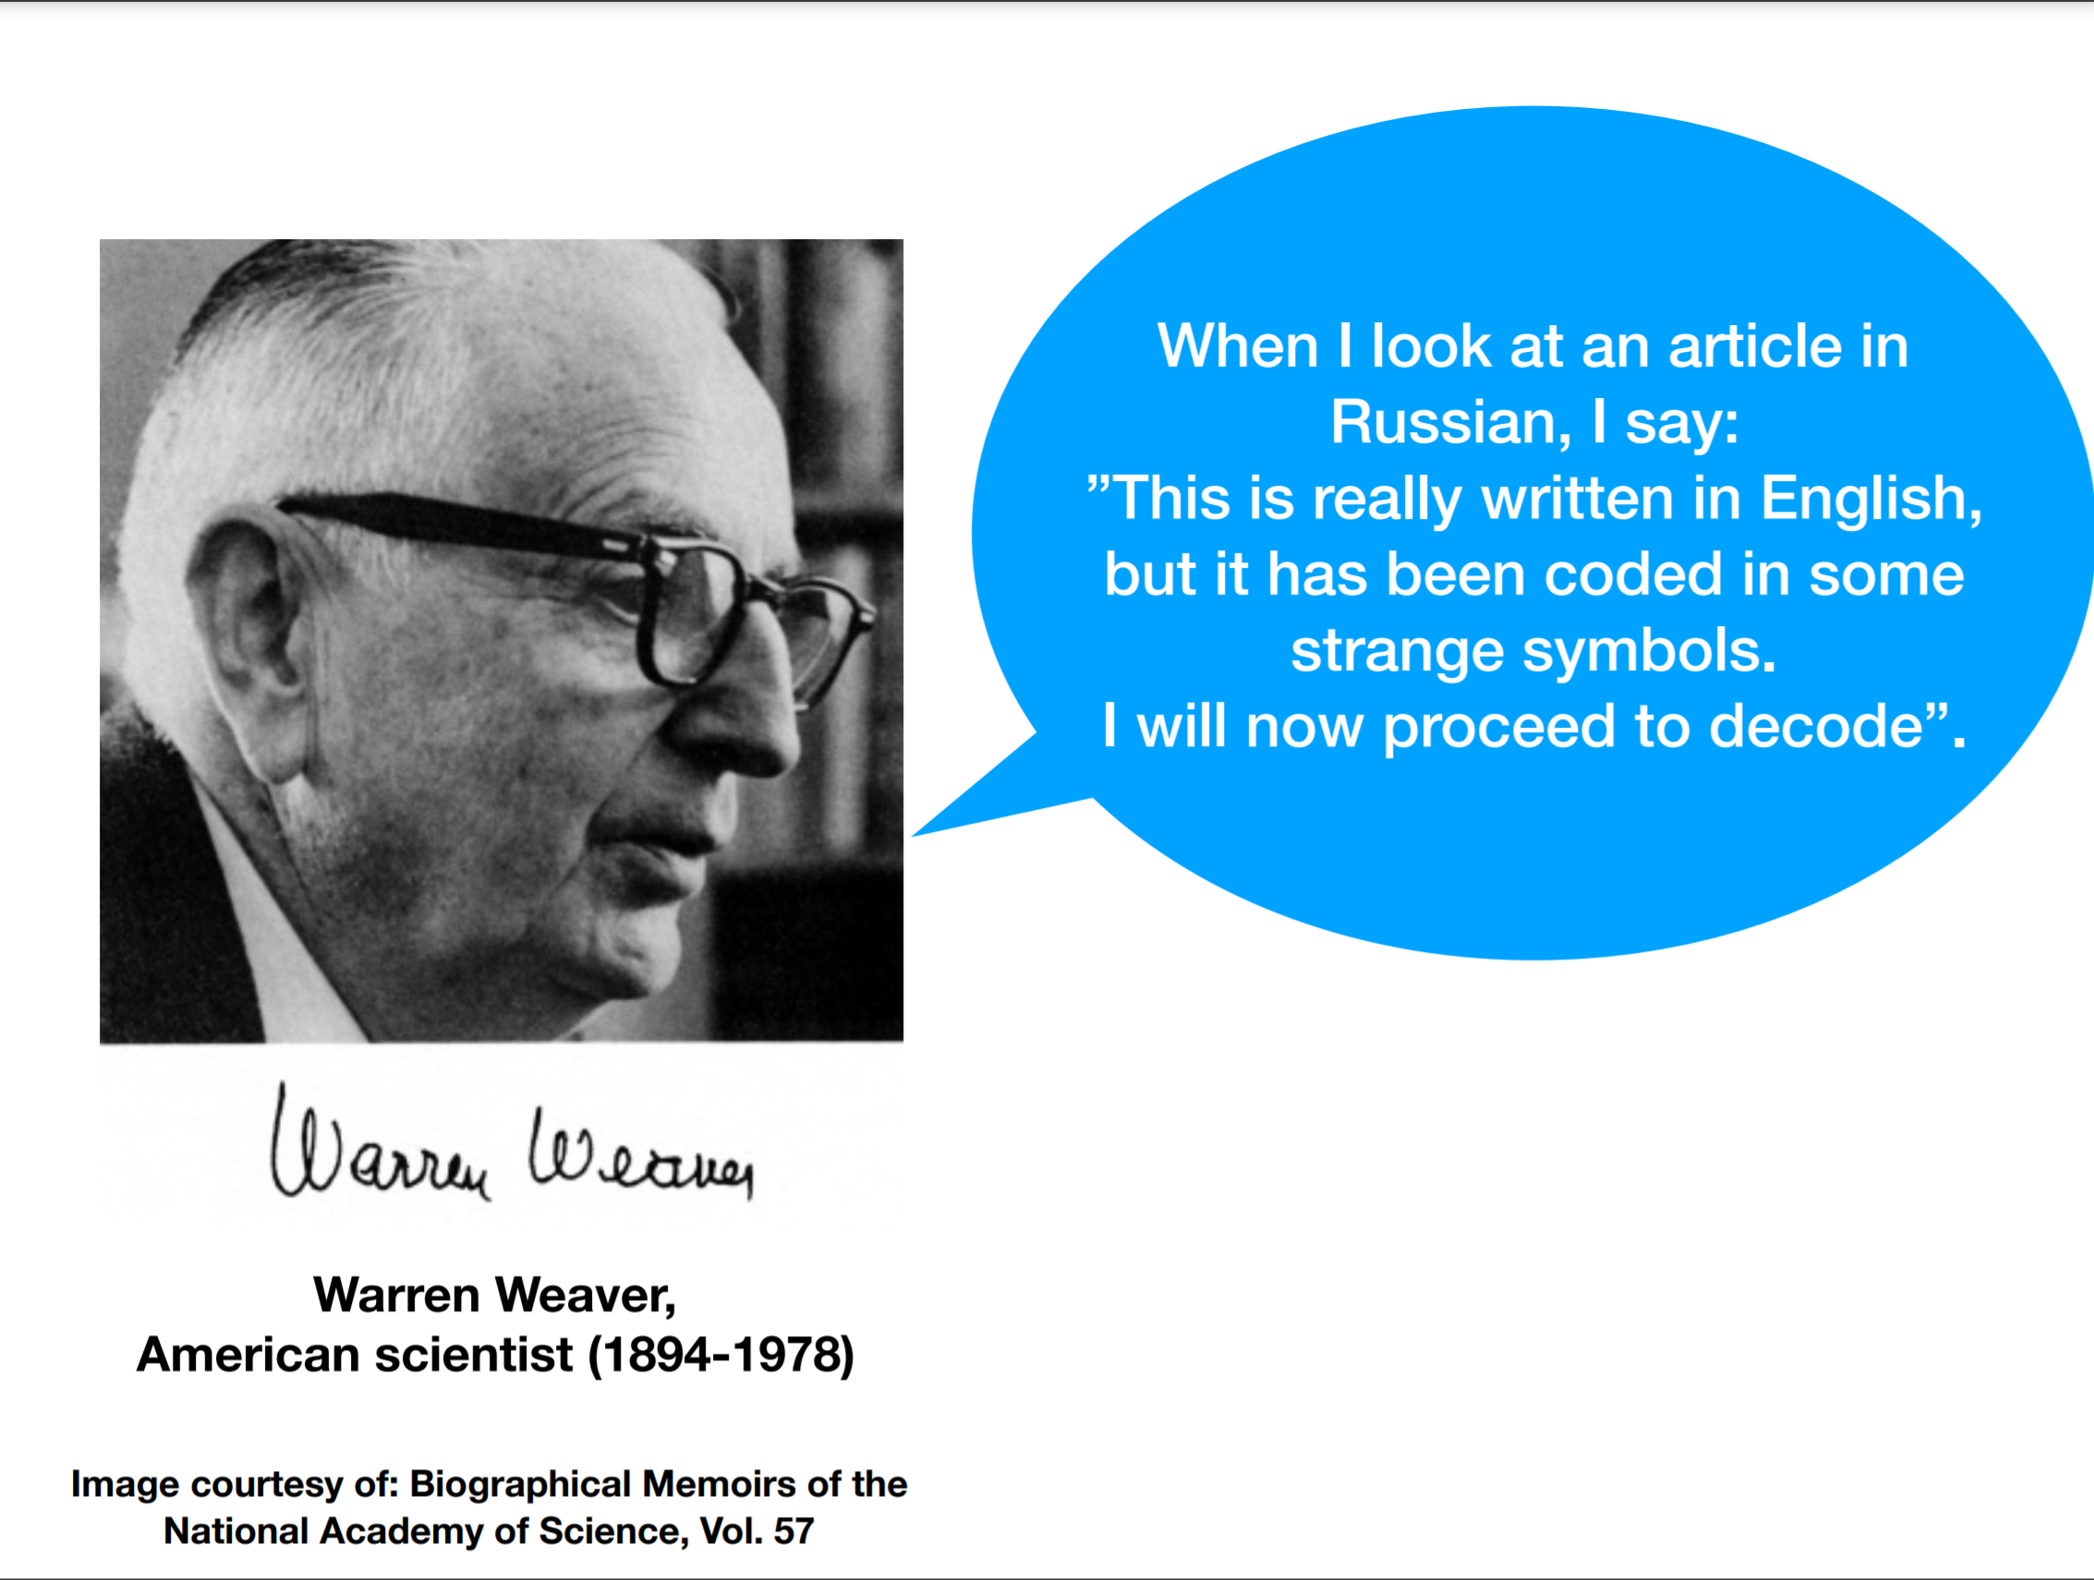

Slide 41
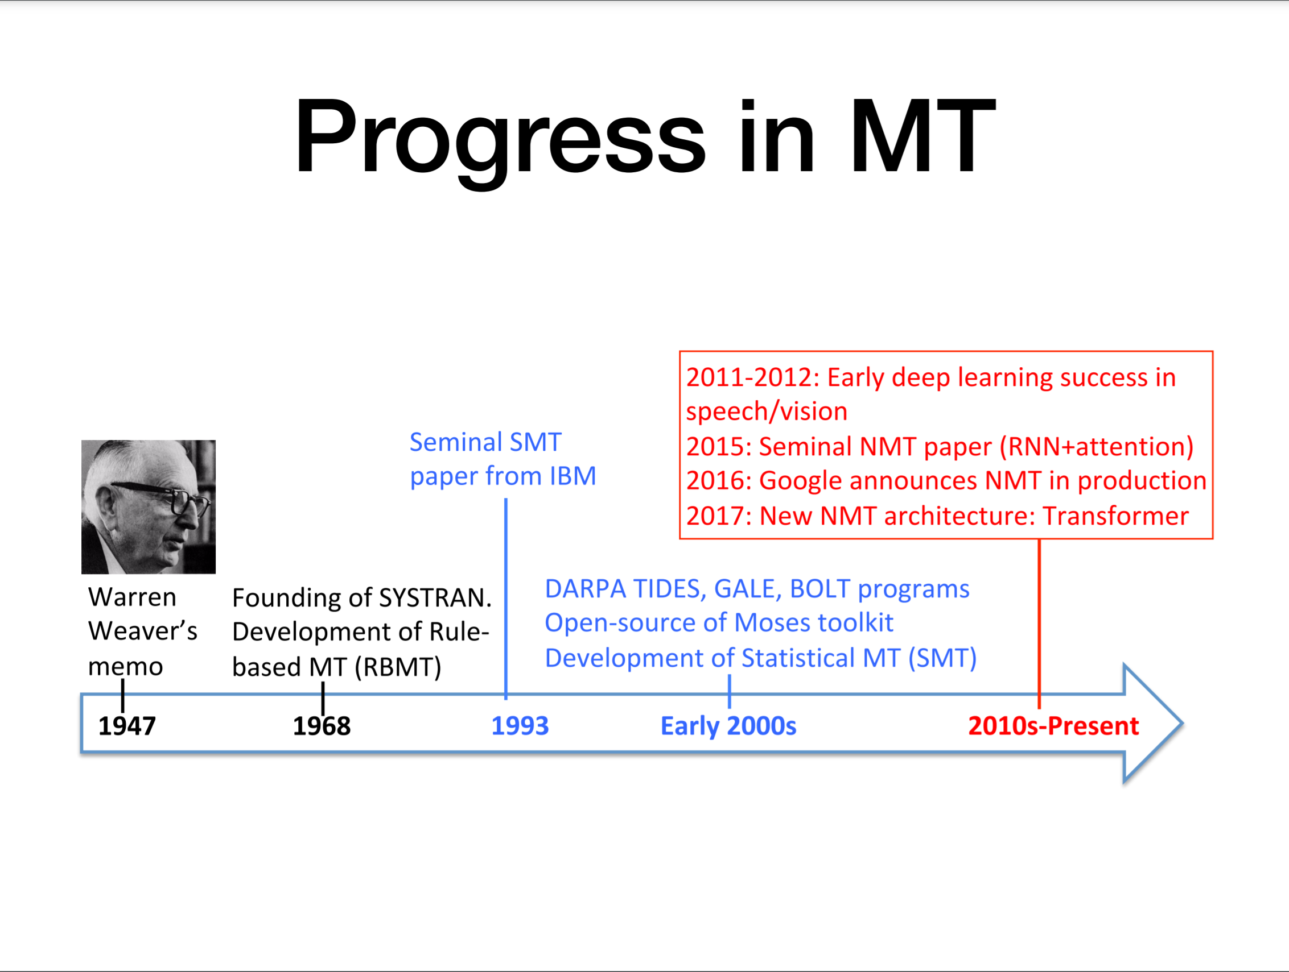

Slide 42
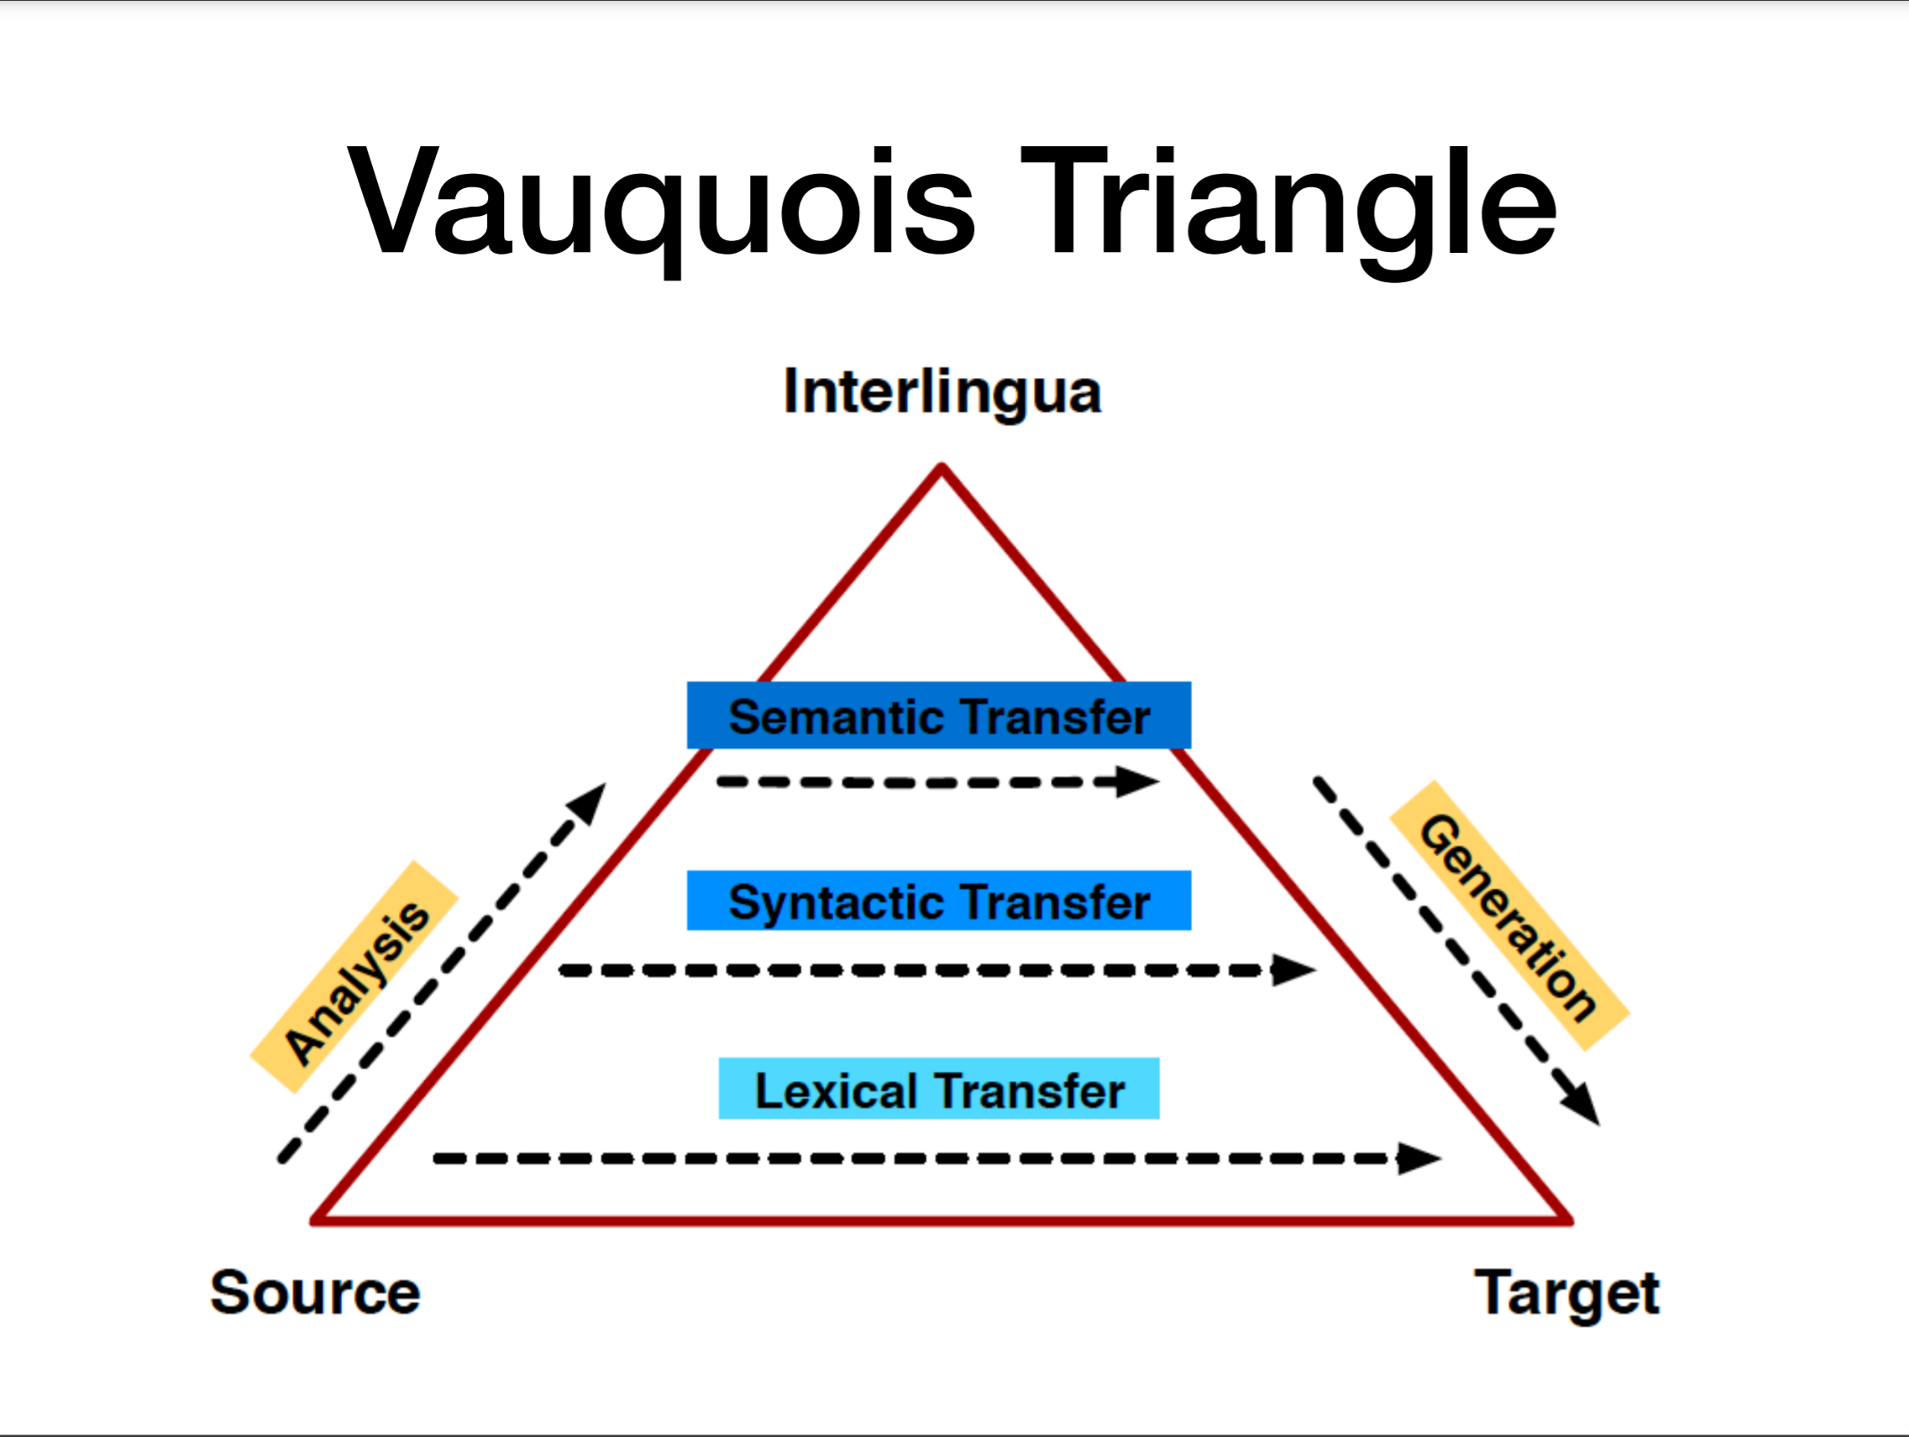

Slide 43
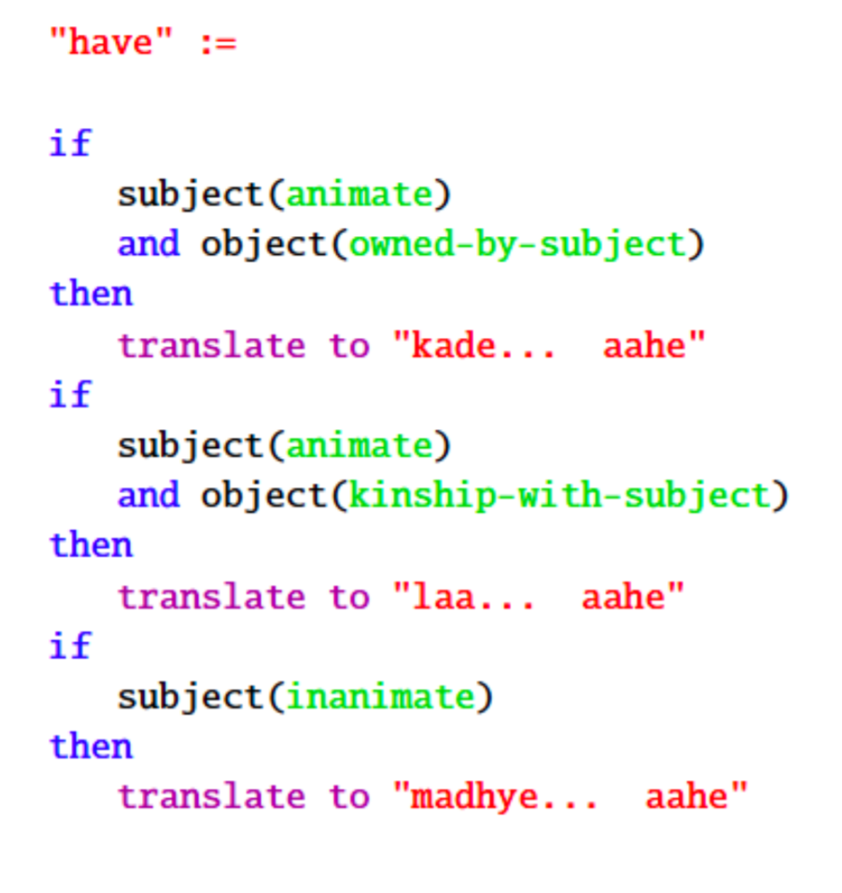
Rule-Based Machine Translation
Build Dictionaries
Write Transformation Rules

Slide 44

Statistical Machine Translation
كيف حالك
How are you?

Slide 45
Statistical Machine Translation
كيف حالك
How are you?
Source sentence, f

Slide 46
Statistical Machine Translation
كيف حالك
How are you?
Source sentence, f
Target sentence, e

Slide 47
Statistical Machine Translation
P(e|f)
كيف حالك
How are you?
Source sentence, f
Target sentence, e

Slide 48
Statistical Machine Translation (SMT)
Data, Data, Data!

Slide 49
Statistical Machine Translation (SMT)
Learn Dictionaries from Data

Slide 50
Statistical Machine Translation (SMT)
Learn Dictionaries from Data “farok” → “jjat”

Slide 51
Statistical Machine Translation (SMT)
Learn Dictionaries from Data “farok” → “jjat”
Learn “Rules” from Data
1980 - 2015

Slide 52
Bitexts
Johns hopkins university was founded
The mascot is a blue jay
Blue jays are the mascot
Lacrosse is a well-known sport
Đại học Johns hopkins được thành lậpLinh vật là một con chim giẻ cùi màu xanhGiẻ cùi xanh là linh vậtLacrosse là một môn thể thao nổi tiếng

Slide 53
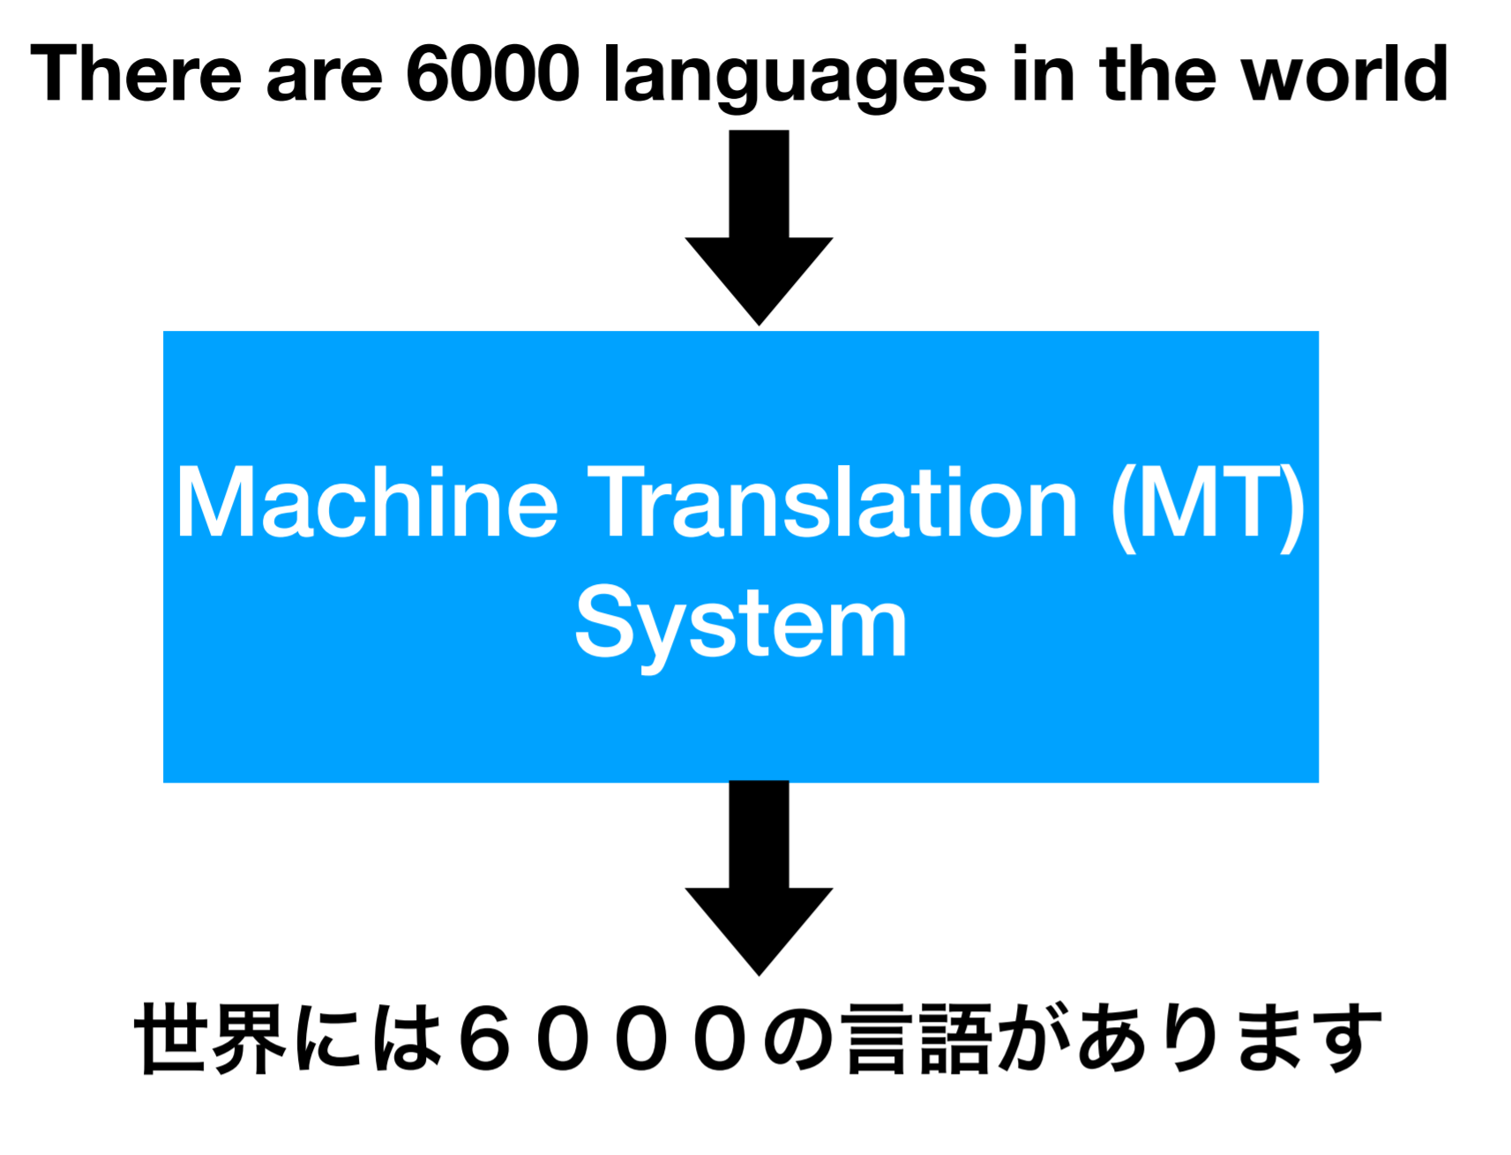
Machine Translation (Abstraction)

Slide 54
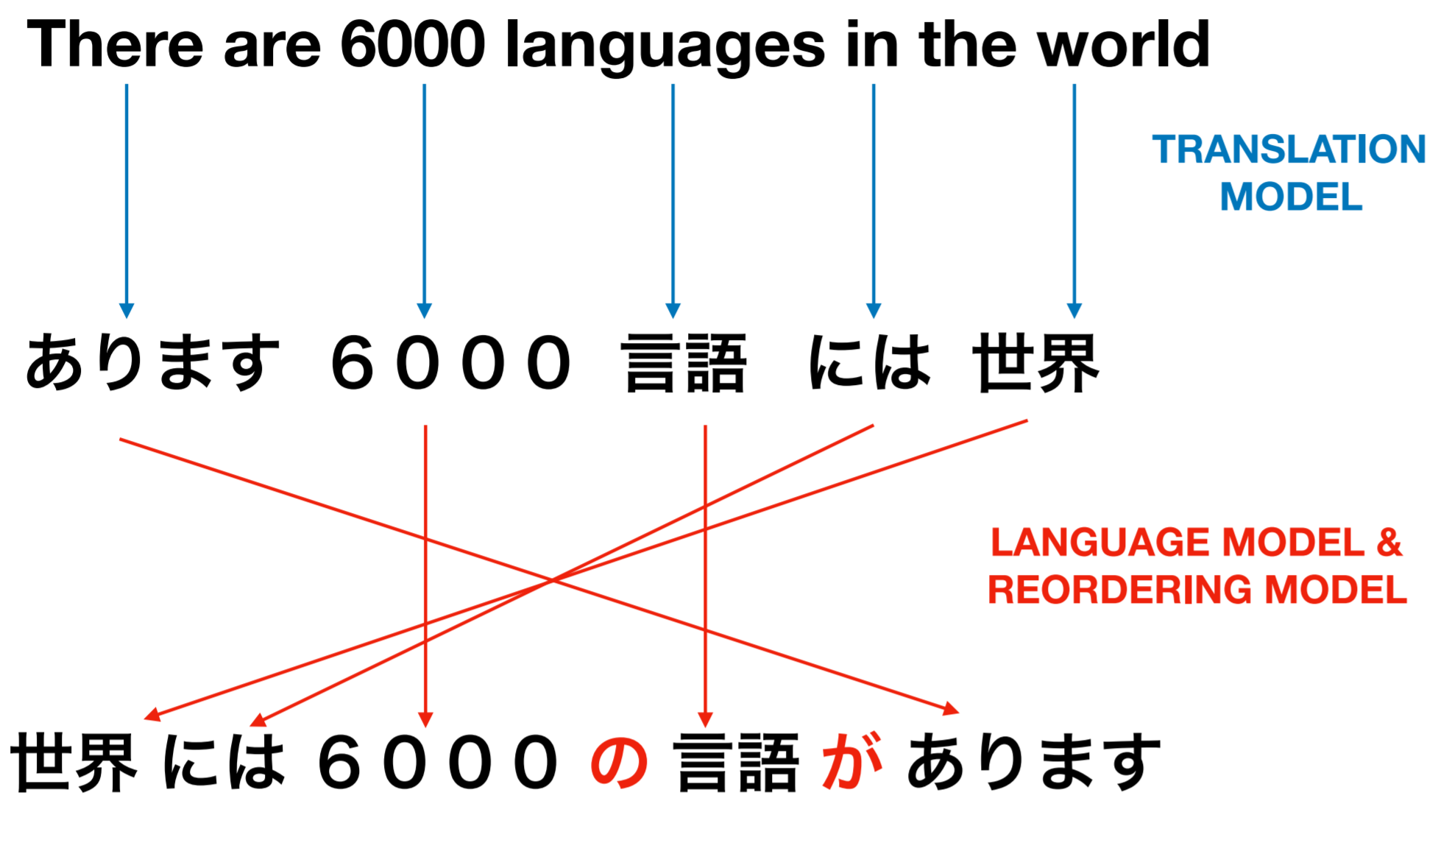
Machine Translation (SMT) … simplified

Slide 55
SMT versus NMT
Statistical MT | Neural MT
Input: Source Sentence

Slide 56
SMT versus NMT
Statistical MT | Neural MT
Input: Source Sentence | Input: Source Sentence

Slide 57
SMT versus NMT
Statistical MT | Neural MT
Input: Source Sentence | Input: Source Sentence
Output: Target Sentence

Slide 58
SMT versus NMT
Statistical MT | Neural MT
Input: Source Sentence | Input: Source Sentence
Output: Target Sentence | Output: Target Sentence

Slide 59
SMT versus NMT
Statistical MT | Neural MT
Input: Source Sentence | Input: Source Sentence
Output: Target Sentence | Output: Target Sentence
Automatically Learn from Bitext

Slide 60
SMT versus NMT
Statistical MT | Neural MT
Input: Source Sentence | Input: Source Sentence
Output: Target Sentence | Output: Target Sentence
Automatically Learn from Bitext | Automatically Learn from Bitext

Slide 61
SMT versus NMT
Statistical MT | Neural MT
Input: Source Sentence | Input: Source Sentence
Output: Target Sentence | Output: Target Sentence
Automatically Learn from Bitext | Automatically Learn from Bitext
Probabilistic Translation Model

Slide 62
SMT versus NMT
Statistical MT | Neural MT
Input: Source Sentence | Input: Source Sentence
Output: Target Sentence | Output: Target Sentence
Automatically Learn from Bitext | Automatically Learn from Bitext
Probabilistic Translation Model
Probabilistic Reordering Model

Slide 63
SMT versus NMT
Statistical MT | Neural MT
Input: Source Sentence | Input: Source Sentence
Output: Target Sentence | Output: Target Sentence
Automatically Learn from Bitext | Automatically Learn from Bitext
Probabilistic Translation Model
Probabilistic Reordering Model
Probabilistic Language Model

Slide 64
SMT versus NMT
Statistical MT | Neural MT
Input: Source Sentence | Input: Source Sentence
Output: Target Sentence | Output: Target Sentence
Automatically Learn from Bitext | Automatically Learn from Bitext
Probabilistic Translation Model | One Neural Model (Probabilistic)
Probabilistic Reordering Model
Probabilistic Language Model

Slide 65
Neural Machine Translation (NMT)
Also a type of Statistical MT
Represent words in high-dimensional, continuous, space
P(e|f)

Slide 66
Neural Machine Translation (NMT)
Encoder
Mach@ ine Le@ rn@ ing is fun </s>

Slide 67
Neural Machine Translation (NMT)
Decoder
Encoder
Mach@ ine Le@ rn@ ing is fun </s>
<bos>

Slide 68
Neural Machine Translation (NMT)
Ap@
Decoder
Encoder
Mach@ ine Le@ rn@ ing is fun </s>
<bos>

Slide 69
Neural Machine Translation (NMT)
Ap@ re@
Decoder
Encoder
Mach@ ine Le@ rn@ ing is fun </s>
<bos> ap@

Slide 70
Neural Machine Translation (NMT)
Ap@ re@ nd@
Decoder
Encoder
Mach@ ine Le@ rn@ ing is fun </s>
<bos> ap@ re@

Slide 71
Neural Machine Translation (NMT)
Ap@ re@ nd@ …… </s>
Decoder
Encoder
Mach@ ine Le@ rn@ ing is fun </s>
<bos> ap@ re@

Slide 72
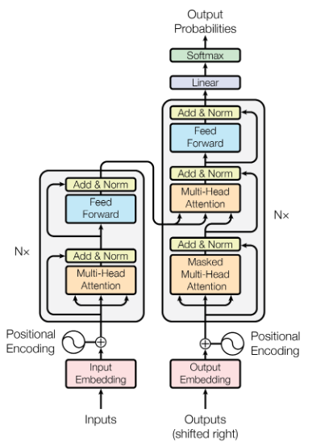
Neural Machine Translation (NMT)
Ap@ re@ nd@ …… </s>
Decoder
Encoder
Mach@ ine Le@ rn@ ing is fun </s>
<bos> ap@ re@

Slide 73
Neural Machine Translation (NMT)
Ap@ re@ nd@ …… </s>
Decoder
Encoder
Mach@ ine Le@ rn@ ing is fun </s>
<bos> ap@ re@

Slide 74
Vocabulary

Slide 75
One-Hot Vector
Words correspond to index in vector
Fixed size

Slide 76
One-Hot Vector
Dictionary
The And I Dog Johns ……. Me Cat
Johns Hopkins was founded in …..
0 0 0 0 1 …… 0 0

Slide 77
Vocabulary Size
Fixed Input & Output Vector Dimensions
Out-of-vocabulary (OOVs)
0.2 0.15 0.001 0.3 …………………………………………… 0.4
le et moi pour …………………………………………… </unk>
0 0 1 0 ……………………………………. 0
The and me for …………………………………………… </unk>

Slide 78
Character Level
No OOVs
Very long sequences

Slide 79
Byte Pair Encoding
Subword Unit
Based on a compression algorithm
Start small, repeatedly combine

Slide 80
peter piper picked a peck of pickled peppers

Slide 81
p@ e@ t@ e@ r p@ i@ p@ e@ r p@ i@ c@ k@ e@ d a p@ e@ c@ k o@ f p@ i@ c@ k@ l@ e@ d p@ e@ p@ p@ e@ r@ s
Vocabulary | Rules
p e t r i c k d a o f l s

Slide 82
p@ e@ t@ e@ r p@ i@ p@ e@ r p@ i@ c@ k@ e@ d a p@ e@ c@ k o@ f p@ i@ c@ k@ l@ e@ d p@ e@ p@ p@ e@ r@ s
Vocabulary | Rules
p e t r i c k d a o f l s pe@ | p@ e@ → pe@

Slide 83
pe@ t@ e@ r p@ i@ p@ e@ r p@ i@ c@ k@ e@ d a pe@ c@ k o@ f p@ i@ c@ k@ l@ e@ d pe@ p@ pe@ r@ s
Vocabulary | Rules
p e t r i c k d a o f l s pe@ pi@ | p@ e@ → pe@ p@ i@ → pi@

Slide 84
pe@ t@ e@ r pi@ p@ e@ r pi@ c@ k@ e@ d a pe@ c@ k o@ f pi@ c@ k@ l@ e@ d pe@ p@ pe@ r@ s
Vocabulary | Rules
p e t r i c k d a o f l s pe@ pi@ pic@ | p@ e@ → pe@ p@ i@ → pi@ pi@ c@ → pic@

Slide 85
pe@ t@ e@ r pi@ p@ e@ r pic@ k@ e@ d a pe@ c@ k o@ f pic@ k@ l@ e@ d pe@ p@ pe@ r@ s
Vocabulary | Rules
p e t r i c k d a o f l s pe@ pi@ pic@ | p@ e@ → pe@ p@ i@ → pi@ pi@ c@ → pic@ e@ d → ed

Slide 86
peter piper picked a peck of pickled peppers
Vocabulary | Rules
p e t r i c k d a o f l s pe@ pi@ pic@ ................................ of | p@ e@ → pe@ p@ i@ → pi@ pi@ c@ → pic@ e@ d → ed . . . . . o@ f → of

Slide 87
How Good are our Translations?
“Iyunivesithi yasekwa ngonyaka olandelayo ukusweleka kwakhe kwaye yanikezelwa kunyana wabo okuphela kwakhe.”
The university was founded in the year following his death and was dedicated to their only son.
The university was following his death and was dedicated to their only son.
Machine Translation always works perfectly.

Slide 88
MT Evaluation
Human Evaluation (Expensive, but best)
Automatic (Cheap, can be correlated)

Slide 89
BLEU Scores
Modified n-gram precision
BiLingual Evaluation Understudy

Slide 90
BLEU Scores
Gold:
The Blue Jays are the mascot of Johns Hopkins University and can be seen around campus.
Hyp:
The Blue Jays are mascot of Johns Hopkins University University and can be seen around.

Slide 91
BLEU Scores
Gold:
The Blue Jays are the mascot of Johns Hopkins University and can be seen around campus
Hyp:
The Blue Jays are mascot of Johns Hopkins University University and can be seen around
Unigrams | Bigrams | Trigrams | 4-grams
14/15

Slide 92
BLEU Scores
Gold:
The Blue Jays are the mascot of Johns Hopkins University and can be seen around campus
Hyp:
The Blue Jays are mascot of Johns Hopkins University University and can be seen around
Unigrams | Bigrams | Trigrams | 4-grams
14/15

Slide 93
BLEU Scores
Gold:
The Blue Jays are the mascot of Johns Hopkins University and can be seen around campus
Hyp:
The Blue Jays are mascot of Johns Hopkins University University and can be seen around
Unigrams | Bigrams | Trigrams | 4-grams
14/15

Slide 94
BLEU Scores
Gold:
The Blue Jays are the mascot of Johns Hopkins University and can be seen around campus
Hyp:
The Blue Jays are mascot of Johns Hopkins University University and can be seen around
Unigrams | Bigrams | Trigrams | 4-grams
14/15 | 12/14

Slide 95
BLEU Scores
Gold:
The Blue Jays are the mascot of Johns Hopkins University and can be seen around campus
Hyp:
The Blue Jays are mascot of Johns Hopkins University University and can be seen around
Unigrams | Bigrams | Trigrams | 4-grams
14/15 | 12/14 | /13

Slide 96
BLEU Scores
Gold:
The Blue Jays are the mascot of Johns Hopkins University and can be seen around campus
Hyp:
The Blue Jays are mascot of Johns Hopkins University University and can be seen around
Unigrams | Bigrams | Trigrams | 4-grams
14/15 | 12/14 | 9/13

Slide 97
BLEU Scores
Gold:
The Blue Jays are the mascot of Johns Hopkins University and can be seen around campus
Hyp:
The Blue Jays are mascot of Johns Hopkins University University and can be seen around
Unigrams | Bigrams | Trigrams | 4-grams
14/15 | 12/14 | 9/13 | /12

Slide 98
BLEU Scores
Gold:
The Blue Jays are the mascot of Johns Hopkins University and can be seen around campus
Hyp:
The Blue Jays are mascot of Johns Hopkins University University and can be seen around
Unigrams | Bigrams | Trigrams | 4-grams
14/15 | 12/14 | 9/13 | /12

Slide 99
BLEU Scores
Gold:
The Blue Jays are the mascot of Johns Hopkins University and can be seen around campus
Hyp:
The Blue Jays are mascot of Johns Hopkins University University and can be seen around
Unigrams | Bigrams | Trigrams | 4-grams
14/16 | 12/15 | 9/14 | /13

Slide 100
BLEU Scores
Gold:
The Blue Jays are the mascot of Johns Hopkins University and can be seen around campus
Hyp:
The Blue Jays are mascot of Johns Hopkins University University and can be seen around
Unigrams | Bigrams | Trigrams | 4-grams
14/15 | 12/14 | 9/13 | /12

Slide 101
BLEU Scores
Gold:
The Blue Jays are the mascot of Johns Hopkins University and can be seen around campus
Hyp:
The Blue Jays are mascot of Johns Hopkins University University and can be seen around
Unigrams | Bigrams | Trigrams | 4-grams
14/15 | 12/14 | 9/13 | 6/12

Slide 102
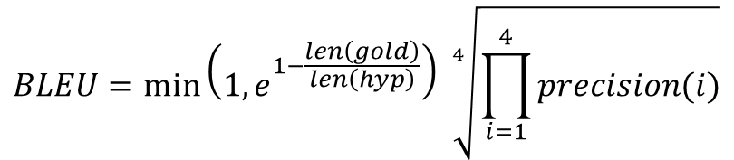
BLEU Scores
$$BLEU=\min\left(1, e^{1−\frac{len\left(gold\right)}{len\left(hyp\right)}}\right) \sqrt[4]{\prod_{i=1}^{4}{precision(i)}}$$
Unigrams | Bigrams | Trigrams | 4-grams
14/15 | 12/14 | 9/13 | 6/12

Slide 103
BLEU Scores
$$BLEU=\min\left(1, e^{1−\frac{len\left(gold\right)}{len\left(hyp\right)}}\right) \sqrt[4]{\prod_{i=1}^{4}{precision(i)}}$$
Brevity Penalty
Unigrams | Bigrams | Trigrams | 4-grams
14/15 | 12/14 | 9/13 | 6/12

Slide 104
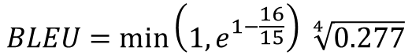
BLEU Scores
$$BLEU=\min\left(1, e^{1−\frac{len\left(gold\right)}{len\left(hyp\right)}}\right) \sqrt[4]{\prod_{i=1}^{4}{precision(i)}}$$
$$BLEU=\min\left(1, e^{1−\frac{16}{15}}\right) \sqrt[4]{0.277}$$
Unigrams | Bigrams | Trigrams | 4-grams
14/15 | 12/14 | 9/13 | 6/12

Slide 105
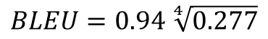
BLEU Scores
$$BLEU=\min\left(1, e^{1−\frac{len\left(gold\right)}{len\left(hyp\right)}}\right) \sqrt[4]{\prod_{i=1}^{4}{precision(i)}}$$
$$BLEU=0.94 \sqrt[4]{0.277}$$
Unigrams | Bigrams | Trigrams | 4-grams
14/15 | 12/14 | 9/13 | 6/12

Slide 106
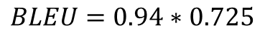
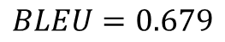
BLEU Scores
$$BLEU=\min\left(1, e^{1−\frac{len\left(gold\right)}{len\left(hyp\right)}}\right) \sqrt[4]{\prod_{i=1}^{4}{precision(i)}}$$
$$BLEU=0.94∗0.725$$
$$BLEU=0.679$$
Unigrams | Bigrams | Trigrams | 4-grams
14/15 | 12/14 | 9/13 | 6/12

Slide 107
BLEU Scores
Calculate over entire test set (not one sentence)
< 10 …. Pretty useless
10 – 20 … can get some meaning
20 – 30 … looks decent
> 30 starts getting pretty good

Slide 108
BLEU Scores
The large house
A big mansion

Slide 109

fairseq
PyTorch
https://github.com/pytorch/fairseq

